Slide 1
Ebola Virus Disease
CDC Slides for U.S. Healthcare Workers*
October 31, 2014
Presentation is current through October 31, 2014 and will be updated every Friday by 5pm. For the most up-to-date information, please visit www.cdc.gov/ebola.
*Presentation contains materials from CDC, MSF, and WHO
Centers for Disease Control and Prevention
Office of the Director
1

Slide 2
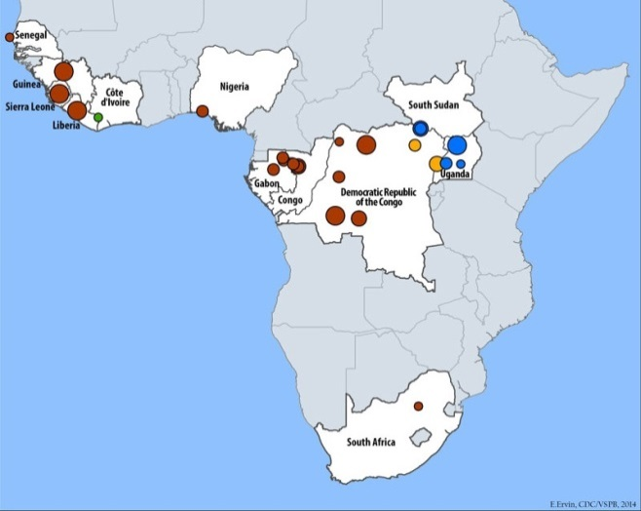
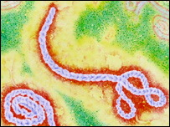
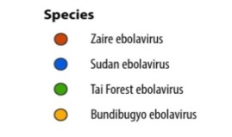
Ebola Virus
Prototype Viral Hemorrhagic Fever Pathogen
  Filovirus: enveloped,
  non-segmented, negative-stranded RNA virus
  Severe disease with high
  case fatality
  Absence of specific treatment or vaccine
>20 previous Ebola and Marburg virus outbreaks
2014 West Africa Ebola outbreak caused by Zaire ebolavirus species (five known Ebola virus species)
2

Slide 3
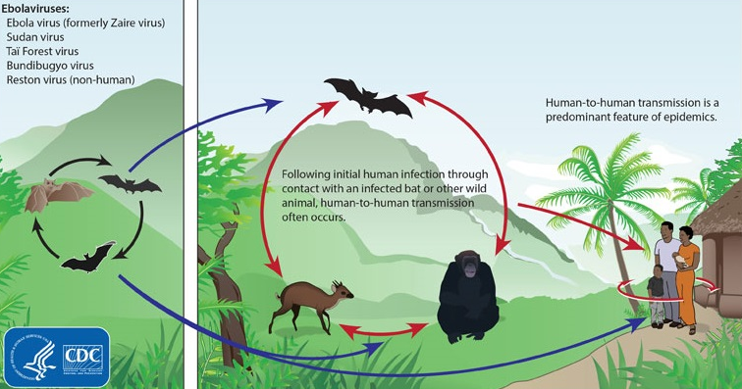
Ebola Virus
Zoonotic virus – bats the most likely reservoir, although species unknown
Spillover event from infected wild animals (e.g., fruit bats, monkey, duiker) to humans, followed by human-human transmission
3

Slide 4
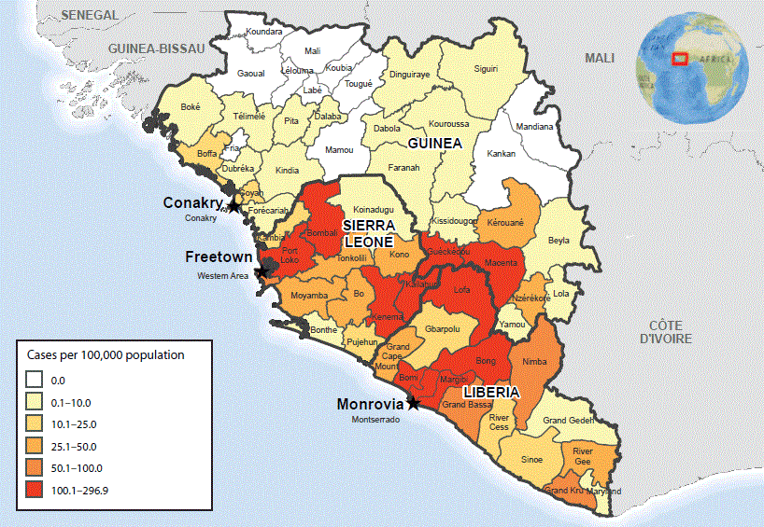
Figure. Ebola virus disease (EVD) cumulative incidence* — West Africa, October 18, 2014
* Cumulative number of reported EVD cases per 100,000 persons since December 22, 2013.
MMWR 2014;63(43):978-981
4

Slide 5
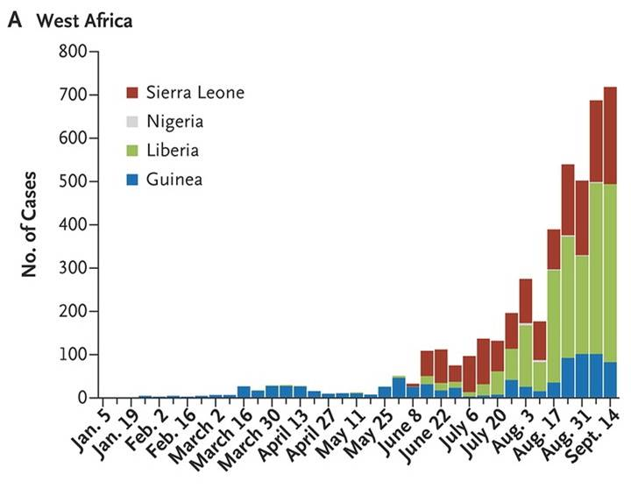
2014 Ebola Outbreak, West Africa
WHO Ebola Response Team. N Engl J Med 2014. DOI: 10.1056/NEJMoa1411100
http://www.nejm.org/doi/full/10.1056/NEJMoa1411100?query=featured_ebola#t=articleResults
5

Slide 6
EVD Cases and Deaths*
 | Reporting Date | Total Cases | Confirmed Cases | Total Deaths
Guinea | 27 Oct 14 | 1,906 | 1,391 | 997
Liberia | 25 Oct 14 | 6,535 | 2,515 | 2,413
Sierra Leone | 27 Oct 14 | 5,235 | 3,700 | 1,500
Nigeria** | 15 Oct 14 | 20 | 19 | 8
Spain | 27 Oct 14 | 1 | 1 | 0
Senegal** | 15 Oct 14 | 1 | 1 | 0
United States | 24 Oct 14 | 4 | 4 | 1
Mali | 23 Oct 14 | 1 | 1 | 1
TOTAL |  | 13,733 | 7,632 | 4,920
Updated case counts available at http://www.cdc.gov/vhf/ebola/outbreaks/2014-west-africa/case-counts.html.
*Reported by WHO using data from Ministries of Health
**The outbreaks of EVD in Senegal and Nigeria were declared over on October 17 and 19, respectively.
6

Slide 7
EVD Cases (United States)
As of October 24, 2014, EVD has been diagnosed in the United States in four people, one (the index patient) who traveled to Dallas, Texas from Liberia, two healthcare workers who cared for the index patient, and one medical aid worker who traveled to New York City from Guinea
  Index patient – Symptoms developed on September 24, 2014 approximately four days after arrival, sought medical care at Texas Health Presbyterian Hospital of Dallas on September 26, was admitted to hospital on September 28, testing confirmed EVD on September 30, patient died October 8.
  TX Healthcare Worker, Case 2 – Cared for index patient, was self-monitoring and presented to hospital reporting low-grade fever, diagnosed with EVD on October 10, recovered and released from NIH Clinical Center October 24.
  TX Healthcare Worker, Case 3 – Cared for index patient, was self-monitoring and reported low-grade fever, diagnosed with EVD on October 15, recovered and released from Emory University Hospital in Atlanta October 28.
  NY Medical Aid Worker, Case 4 – Worked with Ebola patients in Guinea, was self-monitoring and reported fever, diagnosed with EVD on October 24, currently in isolation at Bellevue Hospital in New York City.
Information on U.S. EVD cases available at http://www.cdc.gov/vhf/ebola/outbreaks/2014-west-africa/united-states-imported-case.html.
7

Slide 8
EVD Cases (United States)
As of October 31, 2014, four U.S. health workers and one journalist who were infected with Ebola virus in West Africa were transported to hospitals in the United States for care
  All the patients have recovered and have been released from the hospital after laboratory testing confirmed that they no longer have Ebola virus in their blood
8

Slide 9
Ebola Virus Transmission
Virus present in high quantity in blood, body fluids, and excreta of symptomatic EVD-infected patients
Opportunities for human-to-human transmission
  Direct contact (through broken skin or unprotected mucous membranes) with an EVD-infected patient’s blood or body fluids
  Sharps injury (with EVD-contaminated needle or other sharp)
  Direct contact with the corpse of a person who died of EVD
  Indirect contact with an EVD-infected patient’s blood or body fluids via a contaminated object (soiled linens or used utensils)
Ebola can also be transmitted via contact with blood, fluids, or meat of an infected animal
  Limited evidence that dogs become infected with Ebola virus
  No reports of dogs or cats becoming sick with or transmitting Ebola
9

Slide 10
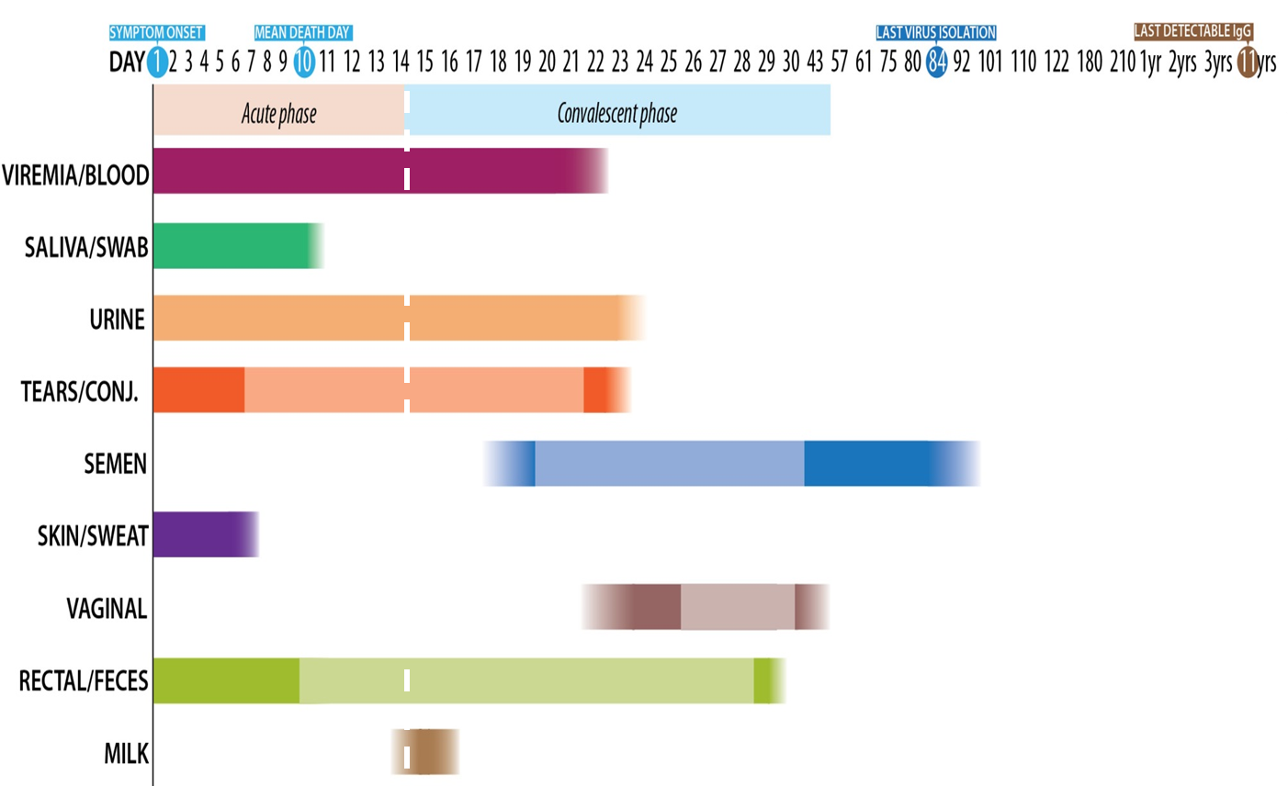
Detection of Ebola Virus in Different
Human Body Fluids over Time
10

Slide 11
Human-to-Human Transmission
Infected persons are not contagious until onset of symptoms
Infectiousness of body fluids (e.g., viral load) increases as patient becomes more ill
  Remains from deceased infected persons are highly infectious
Human-to-human transmission of Ebola virus via inhalation (aerosols) has not been demonstrated
11

Slide 12
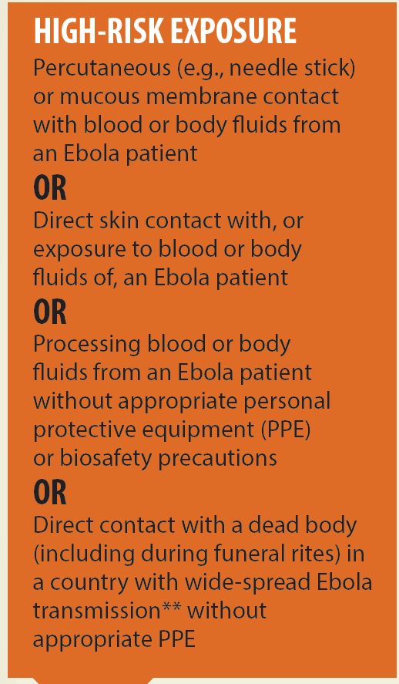
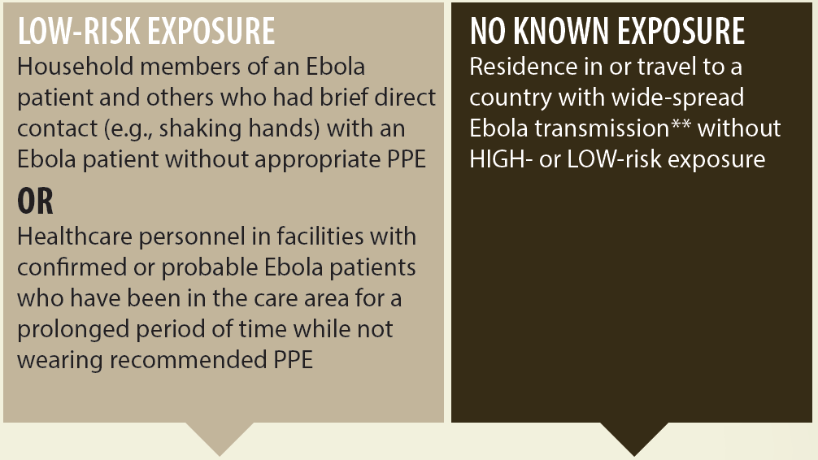
EVD Risk Assessment
**CDC Website to check current affected areas: www.cdc.gov/vhf/ebola

Slide 13
Ebola Virus Pathogenesis
Direct infection of tissues
Immune dysregulation
Hypovolemia and vascular collapse
  Electrolyte abnormalities
  Multi-organ failure, septic shock
Disseminated intravascular coagulation (DIC) and coagulopathy
Lancet. Mar 5, 2011; 377(9768): 849–862.
13

Slide 14
Early Clinical Presentation
Acute onset; typically 8–10 days after exposure
(range 2–21 days)
Signs and symptoms
  Initial: Fever, chills, myalgias, malaise, anorexia
  After 5 days: GI symptoms, such as nausea, vomiting, watery diarrhea, abdominal pain
  Other: Headache, conjunctivitis, hiccups, rash, chest pain, shortness of breath, confusion, seizures
  Hemorrhagic symptoms in 18% of cases
Other possible infectious causes of symptoms
  Malaria, typhoid fever, meningococcemia, Lassa fever and other bacterial infections (e.g., pneumonia) – all very common in Africa
14

Slide 15
Clinical Features
Nonspecific early symptoms progress to:
  Hypovolemic shock and multi-organ failure
  Hemorrhagic disease
  Death
Non-fatal cases typically improve 6–11 days after symptoms onset
Fatal disease associated with more severe early symptoms
  Fatality rates of 70% have been reported in rural Africa
  Intensive care, especially early intravenous and electrolyte management, may increase the survival rate
15

Slide 16
Clinical Manifestations by Organ System in West African Ebola Outbreak
Organ System | Clinical Manifestation
General | Fever (87%), fatigue (76%), arthralgia (39%), myalgia (39%)
Neurological | Headache (53%), confusion (13%), eye pain (8%), coma (6%)
Cardiovascular | Chest pain (37%),
Pulmonary | Cough (30%), dyspnea (23%), sore throat (22%), hiccups (11%)
Gastrointestinal | Vomiting (68%), diarrhea (66%), anorexia (65%), abdominal pain (44%), dysphagia (33%), jaundice (10%)
Hematological | Any unexplained bleeding (18%), melena/hematochezia (6%), hematemesis (4%), vaginal bleeding (3%), gingival bleeding (2%), hemoptysis (2%), epistaxis (2%), bleeding at injection site (2%), hematuria (1%), petechiae/ecchymoses (1%)
Integumentary | Conjunctivitis (21%), rash (6%)
WHO Ebola Response team. NEJM. 2014
16

Slide 17
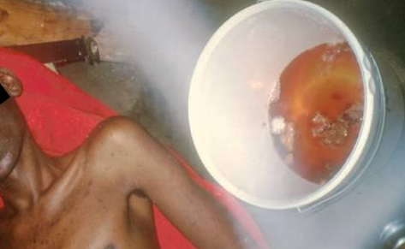
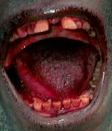
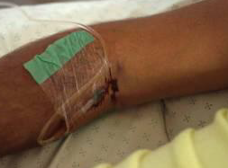
Examples of Hemorrhagic Signs
Hematemesis
Gingival bleeding
Bleeding at IV Site
17

Slide 18
Laboratory Findings
Thrombocytopenia (50,000–100,000/μL range)
Leukopenia followed by neutrophilia
Transaminase elevation: elevation serum aspartate amino-transferase (AST) > alanine transferase (ALT)
Electrolyte abnormalities from fluid shifts
Coagulation: PT and PTT prolonged
Renal: proteinuria, increased creatinine
18

Slide 19
EVD: Expected diagnostic test results over time
Critical information: Date of onset of fever/symptoms
IgM
IgG
viremia
0
3
10
days post onset of symptoms
Fever
RT-PCR
ELISA IgM
ELISA IgG
IgM: up to 3 – 6 months
IgG: 3 – 5 years or more (life-long persistance?)
19

Slide 20
Ebola Virus Diagnosis
Real Time PCR (RT-PCR)
  Used to diagnose acute infection
  More sensitive than antigen detection ELISA
  Identification of specific viral genetic fragments
  Performed in select CLIA-certified laboratories
RT-PCR sample collection
  Volume: minimum volume of 4mL whole blood
  Plastic collection tubes (not glass or heparinized tubes)
  Whole blood preserved with EDTA is preferred
    Whole blood preserved with sodium polyanethol sulfonate (SPS), citrate, or with clot activator is acceptable
20

Slide 21
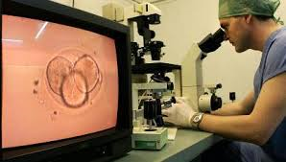
Other Ebola Virus Diagnostics
Virus isolation
  Requires Biosafety Level 4 laboratory;
  Can take several days
Immunohistochemical staining and histopathology
  On collected tissue or dead wild animals; localizes viral antigen
Serologic testing for IgM and IgG antibodies (ELISA)
  Detection of viral antibodies in
  specimens, such as blood, serum,
  or tissue suspensions
  Monitor the immune response
  in confirmed EVD patients
21

Slide 22
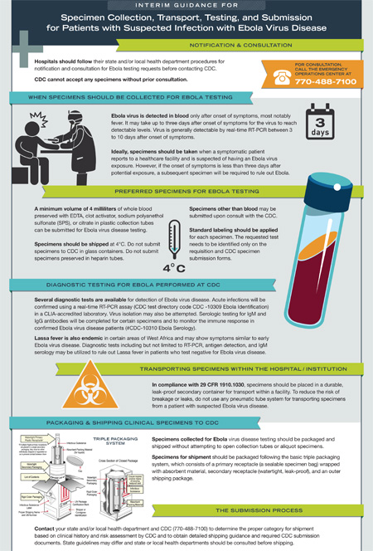
Laboratories
CDC has developed interim guidance for U.S. laboratory workers and other healthcare personnel who collect or handle specimens
This guidance includes information about the appropriate steps for collecting, transporting, and testing specimens from patients who are suspected to be infected with Ebola
Specimens should NOT be shipped to CDC without consultation with CDC and local/state health departments
Information available at: http://www.cdc.gov/vhf/ebola/hcp/interim-guidance-specimen-collection-submission-patients-suspected-infection-ebola.html
22

Slide 23
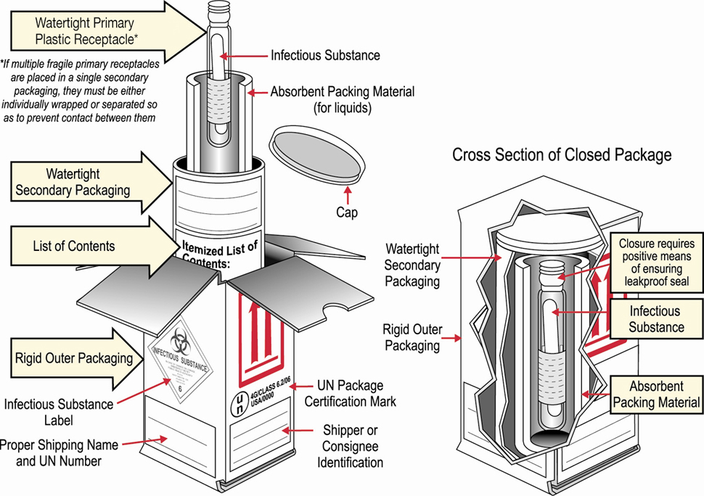
Packaging & Shipping Clinical Specimens to CDC for Ebola Testing
http://www.cdc.gov/vhf/ebola/hcp/packaging-diagram.html
23

Slide 24
Interpreting Negative Ebola RT-PCR Result
If symptoms started ≥3 days before the negative result
  EVD is unlikely → consider other diagnoses
  Infection control precautions for EVD can be discontinued unless clinical suspicion for EVD persists
If symptoms started <3 days before the negative
RT-PCR result
  Interpret result with caution
  Repeat the test at ≥72 hours after onset of symptoms
  Keep in isolation as a suspected case until a repeat RT-PCR ≥72 hours after onset of symptoms is negative
24

Slide 25
Clinical Management of EVD:
Supportive, but Aggressive
Hypovolemia and sepsis physiology
  Aggressive intravenous fluid resuscitation
  Hemodynamic support and critical care management if necessary
Electrolyte and acid-base abnormalities
  Aggressive electrolyte repletion
  Correction of acid-base derangements
Symptomatic management of fever and gastrointestinal symptoms
  Avoid NSAIDS
Multisystem organ failure can develop and may require
  Oxygenation and mechanical ventilation
  Correction of severe coagulopathy
  Renal replacement therapy
Reference: Fowler RA et al. Am J Respir Crit Care Med. 2014
25

Slide 26
Investigational Therapies for EVD Patients
No approved Ebola-specific prophylaxis or treatment
  Ribavirin has no in-vitro or in-vivo effect on Ebola virus
  Therapeutics in development with limited human clinical trial data
    Convalescent serum
    Therapeutic medications
      Zmapp – chimeric human-mouse monoclonal antibodies
      Tekmira – lipid nanoparticle small interfering RNA
      Brincidofovir – oral nucleotide analogue with antiviral activity
  Vaccines – in clinical trials
    Chimpanzee-derived adenovirus with an Ebola virus gene inserted
    Attenuated vesicular stomatitis virus with an Ebola virus gene inserted
References: ¹Huggins, JW et al. Rev Infect Dis 1989; ²Ignatyev, G et al. J Biotechnol 2000; ³Jarhling, P et al. JID 2007 S400; ⁴Mupapa, K et al. JID 1999 S18; ⁵Olinger, GG et al. PNAS 2012; ⁶Dye, JM et al. PNAS 2012; ⁷Qiu, X et al. Sci Transl Med 2013; ⁸Qiu, X et al. Nature 2014; ⁹Geisbert, TW et al. JID 2007; 10Geisbert, TW et al. Lancet 2010; ¹¹Kobinger, GP et al. Virology 2006; ¹²Wang, D JV 2006; ¹³Geisbert, TW et al. JID 2011; and ¹⁴Gunther et al. JID 2011.
26

Slide 27
Patient Recovery
Case-fatality rate 71% in the 2014 Ebola outbreak
  Case-fatality rate is likely much lower with access to intensive care
Patients who survive often have signs of clinical improvement by the second week of illness
  Associated with the development of virus-specific antibodies
  Antibody with neutralizing activity against Ebola persists greater than 12 years after infection
Prolonged convalescence
  Includes arthralgia, myalgia, abdominal pain, extreme fatigue, and anorexia; many symptoms resolve by 21 months
  Significant arthralgia and myalgia may persist for >21 months
  Skin sloughing and hair loss has also been reported
References: ¹WHO Ebola Response Team. NEJM 2014; ²Feldman H & Geisbert TW. Lancet 2011; ³Ksiazek TG et al. JID 1999; ⁴Sanchez A et al. J Virol 2004; ⁵Sobarzo A et al. NEJM 2013; and ⁶Rowe AK et al. JID 1999.
27

Slide 28
Practical Considerations for Evaluating Patients for EVD in the United States
CDC encourages all U.S. healthcare providers to
  Ask patients with symptoms about a history of travel to West Africa in the 21 days before illness onset
  Know the signs and symptoms of EVD
  Know the initial steps to take if a diagnosis of EVD is suspected
CDC has developed documents to facilitate these evaluations
  The EVD algorithm for the evaluation of a returned traveler
    Available at http://www.cdc.gov/vhf/ebola/pdf/ebola-algorithm.pdf
  The checklist for evaluation of a patient being evaluated for EVD
    Available at http://www.cdc.gov/vhf/ebola/pdf/checklist-patients-evaluated-us-evd.pdf
28

Slide 29
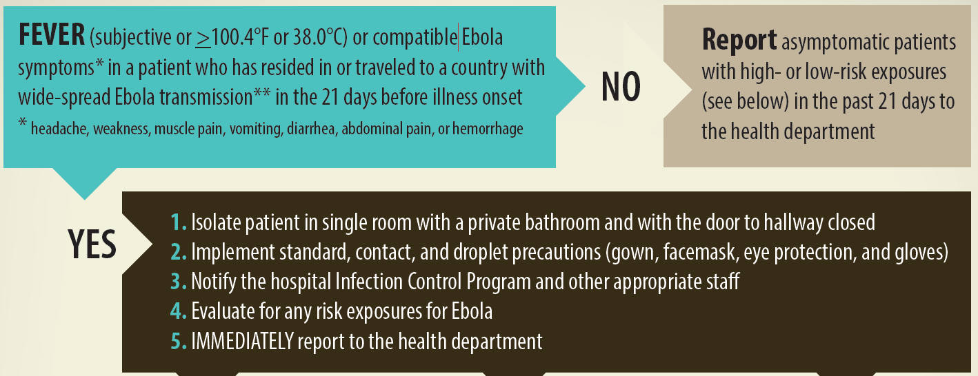
EVD Algorithm for Evaluation of the
Returned Traveler
**CDC Website to check current affected areas: www.cdc.gov/vhf/ebola
Algorithm available at http://www.cdc.gov/vhf/ebola/pdf/ebola-algorithm.pdf
Checklist available at http://www.cdc.gov/vhf/ebola/pdf/checklist-patients-evaluated-us-evd.pdf
29

Slide 30
Interim Guidance for Monitoring and Movement of Persons with EVD Exposure
CDC has created guidance for monitoring people exposed
to Ebola virus but without symptoms
RISK LEVEL | PUBLIC HEALTH ACTION
 | Monitoring | Restricted Public Activities | Restricted Travel
HIGH risk | Direct Active Monitoring | Yes | Yes
SOME risk | Direct Active Monitoring | Case-by-case assessment | Case-by-case assessment
LOW risk | Active Monitoring for some; Direct Active Monitoring for others | No | No
NO risk | No | No | No
  www.cdc.gov/vhf/ebola/hcp/monitoring-and-movement-of-persons-with-exposure.html

Slide 31
EVD Summary
The 2014 Ebola outbreak in West Africa is the largest in history and has affected multiple countries
Think Ebola: U.S. healthcare providers should be aware of clinical presentation and risk factors for EVD
Human-to-human transmission by direct contact
  No human-to-human transmission via inhalation (aerosols)
  No transmission before symptom onset
Early case identification, isolation, treatment and effective infection control are essential to prevent Ebola transmission
31

Slide 32
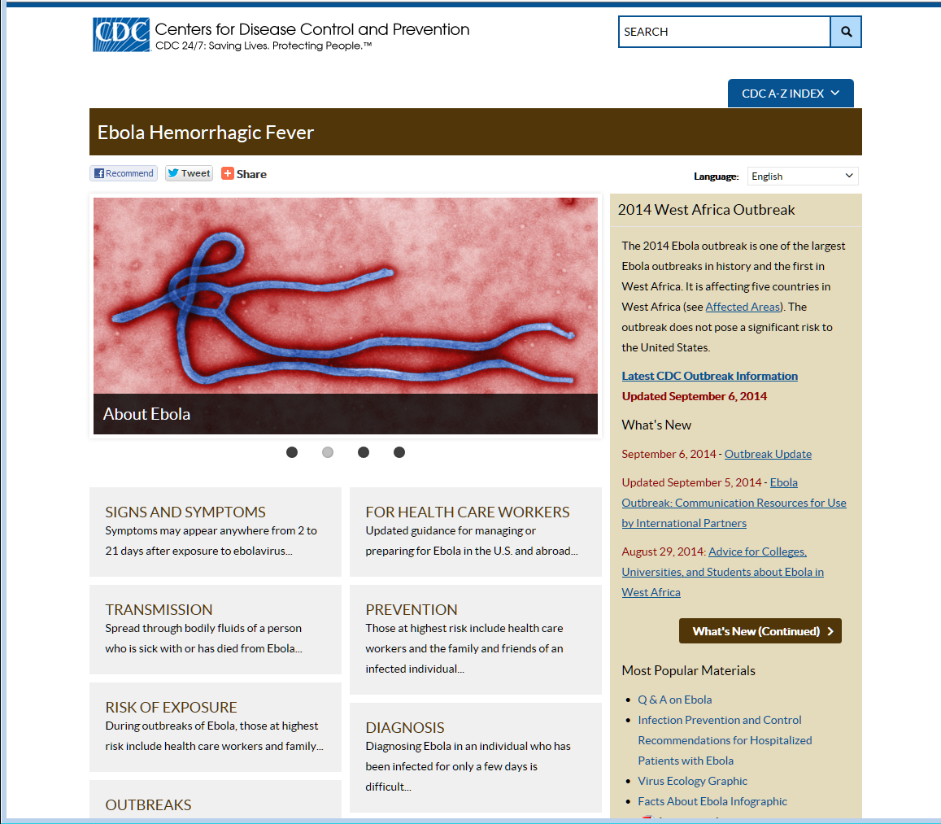
Centers for Disease Control and Prevention
Office of the Director
32

