Slide 1



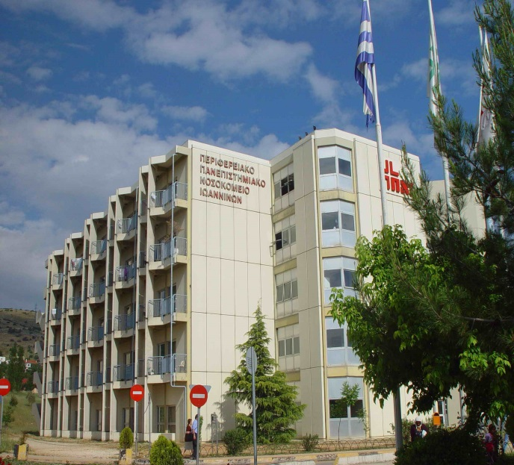
ΟΙΚΟΓΕΝΗΣ ΥΠΕΡΧΟΛΗΣΤΕΡΟΛΑΙΜΙΑ
Ευάγγελος Λυμπερόπουλος
Επίκουρος Καθηγητής Παθολογίας Ιατρικής Σχολής Παν/μίου Ιωαννίνων
www.bpath.gr & www.atherosclerosis.gr

Slide 2
ΜΕΤΑΒΟΛΙΣΜΟΣ ΤΩΝ LDL

Slide 3
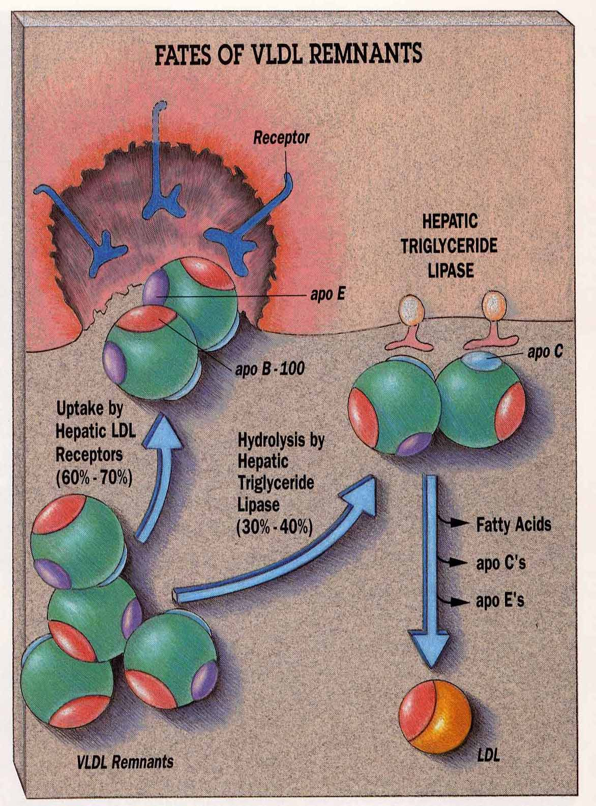

Slide 4
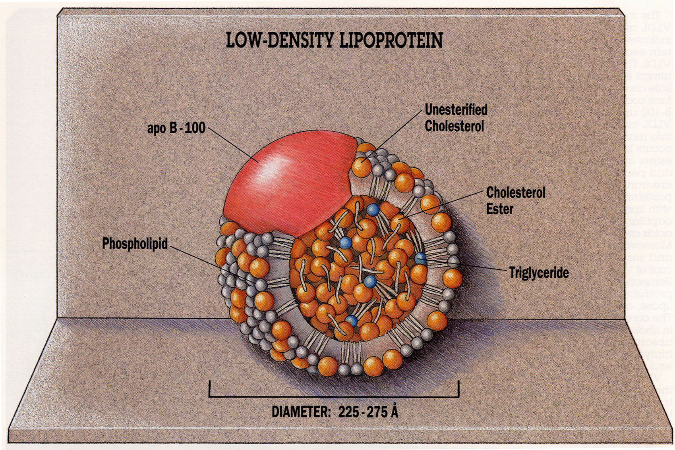

Slide 5
Ο ΡΟΛΟΣ ΤΩΝ LDL
Μεταφορά χοληστερόλης στα κύτταρα
Σύνθεση στεροειδών ορμονών και ορμονών του φύλου

Slide 6
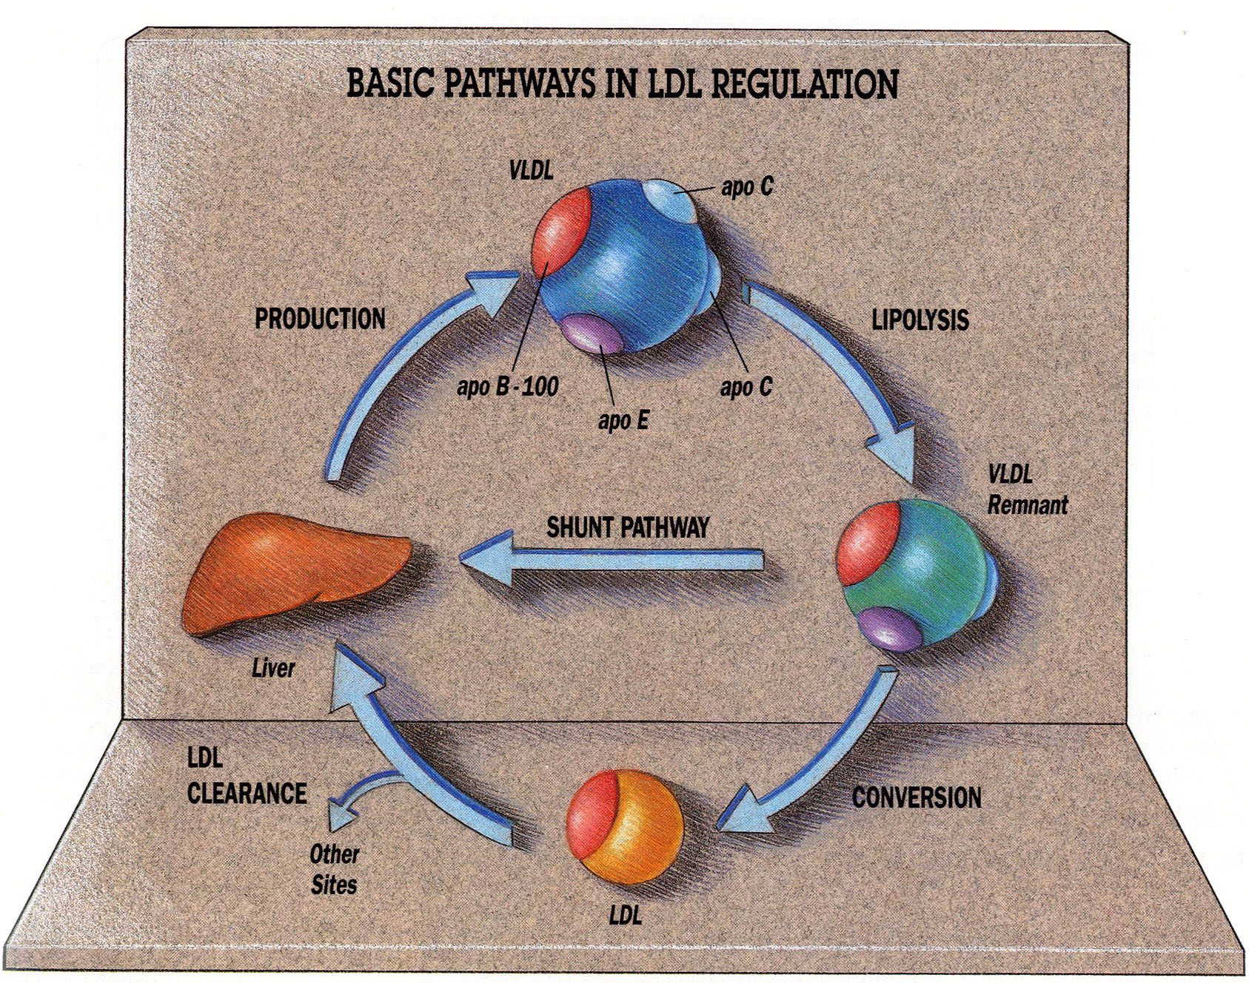

Slide 7
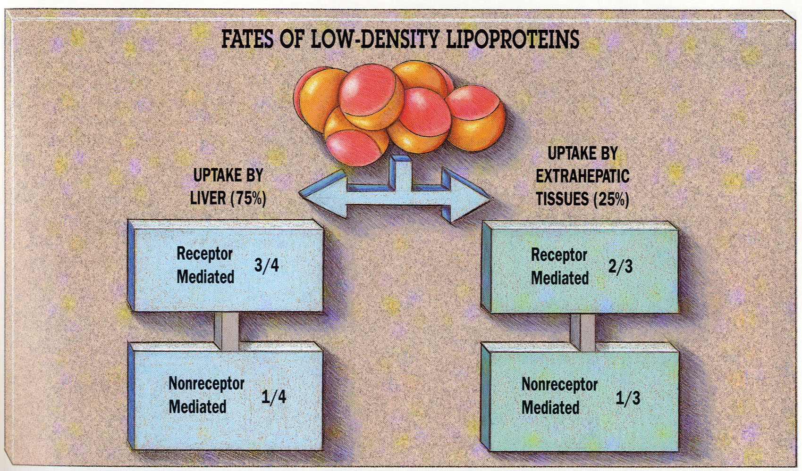

Slide 8
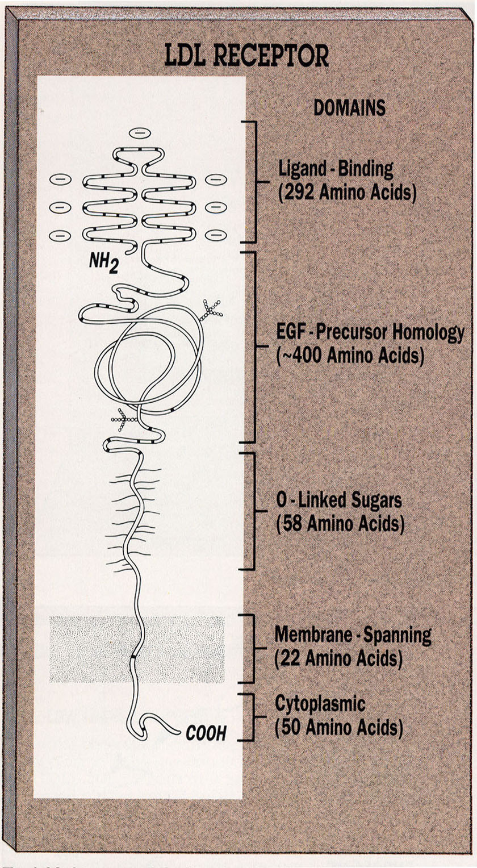

Slide 9
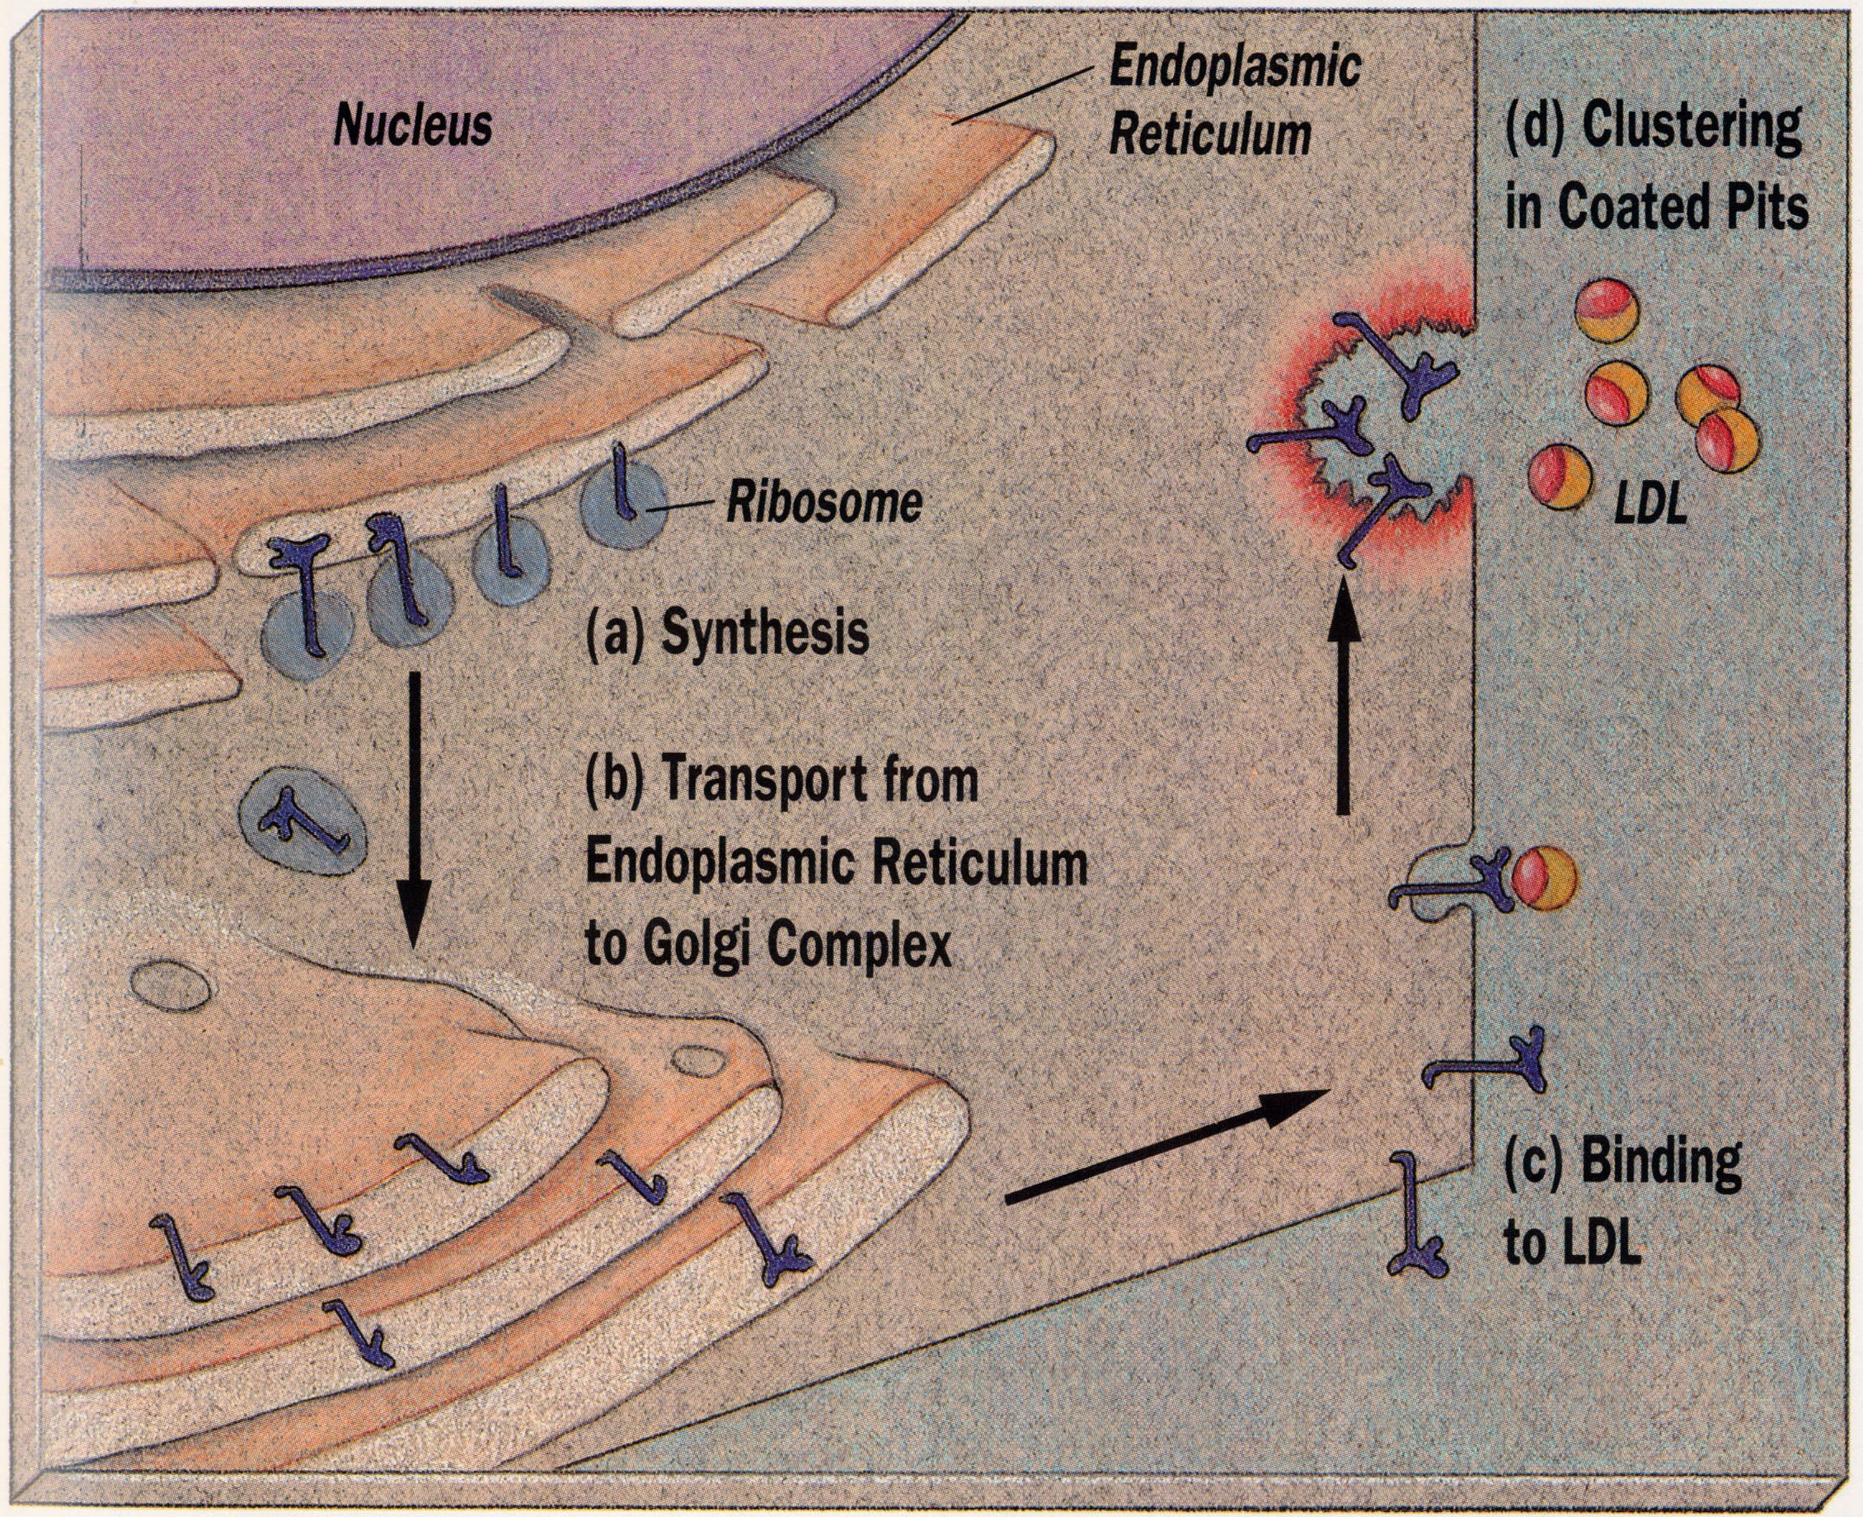

Slide 10
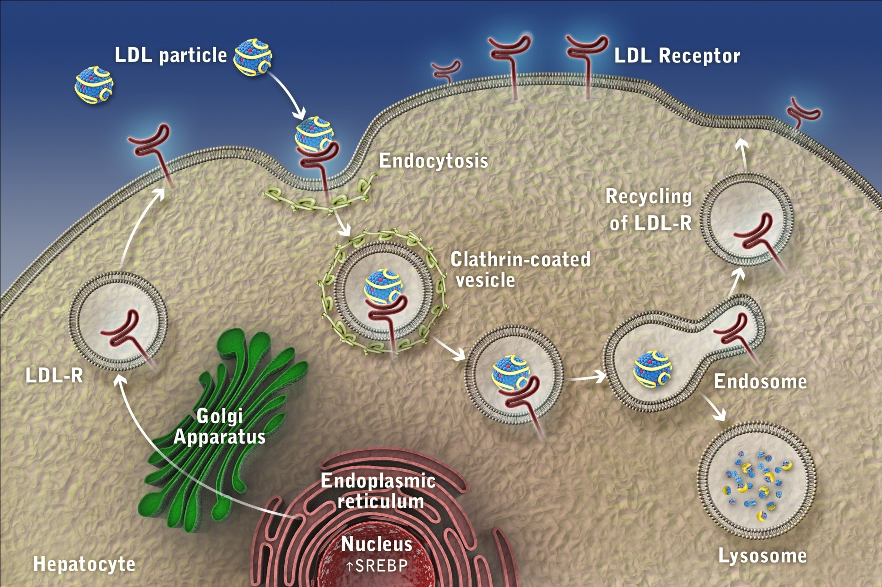
LDL Receptor Function and Life Cycle
10

Slide 11
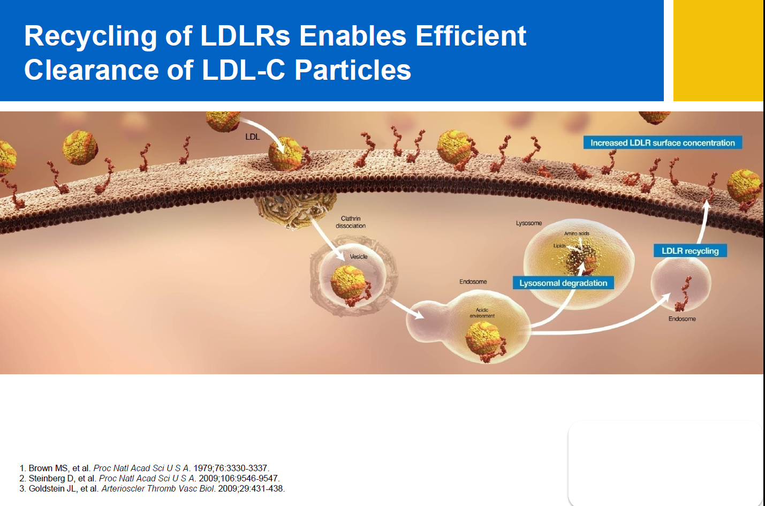

Slide 12
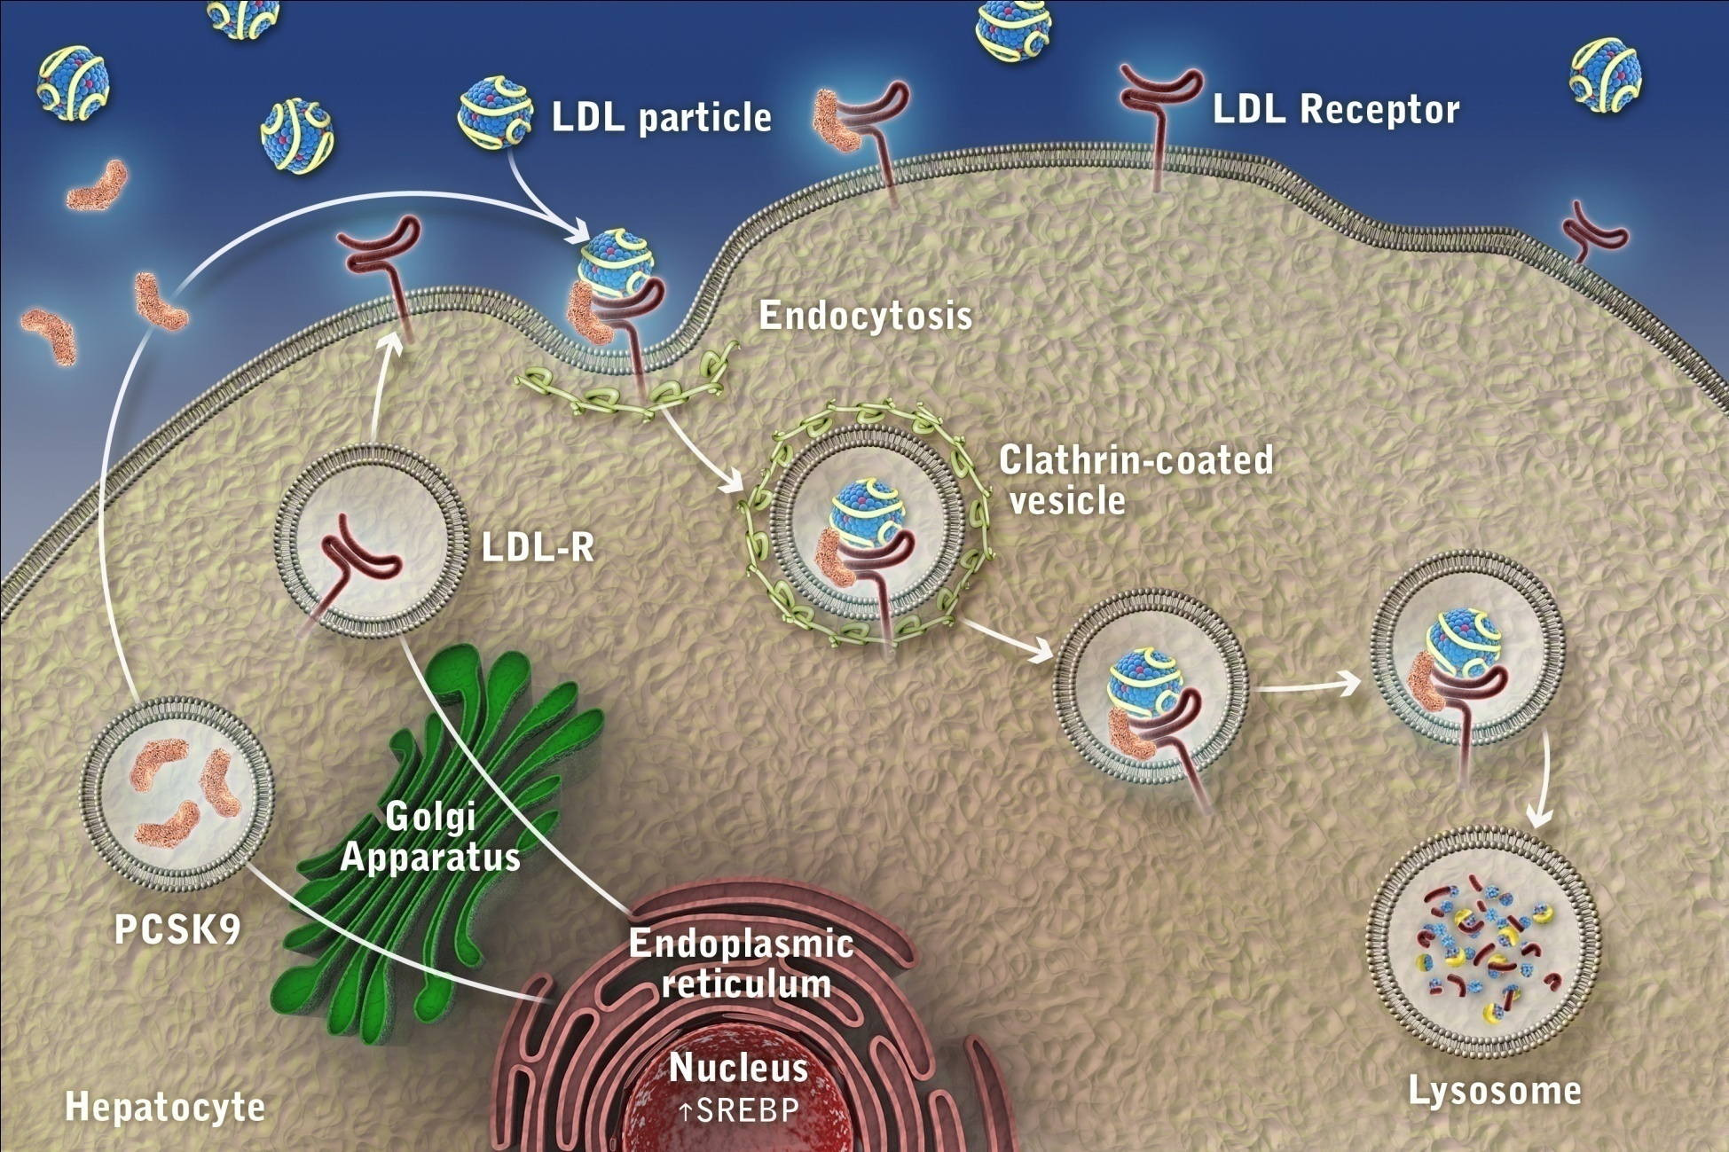
The Role of PCSK9 in the Regulation of LDL Receptor Expression
12

Slide 13
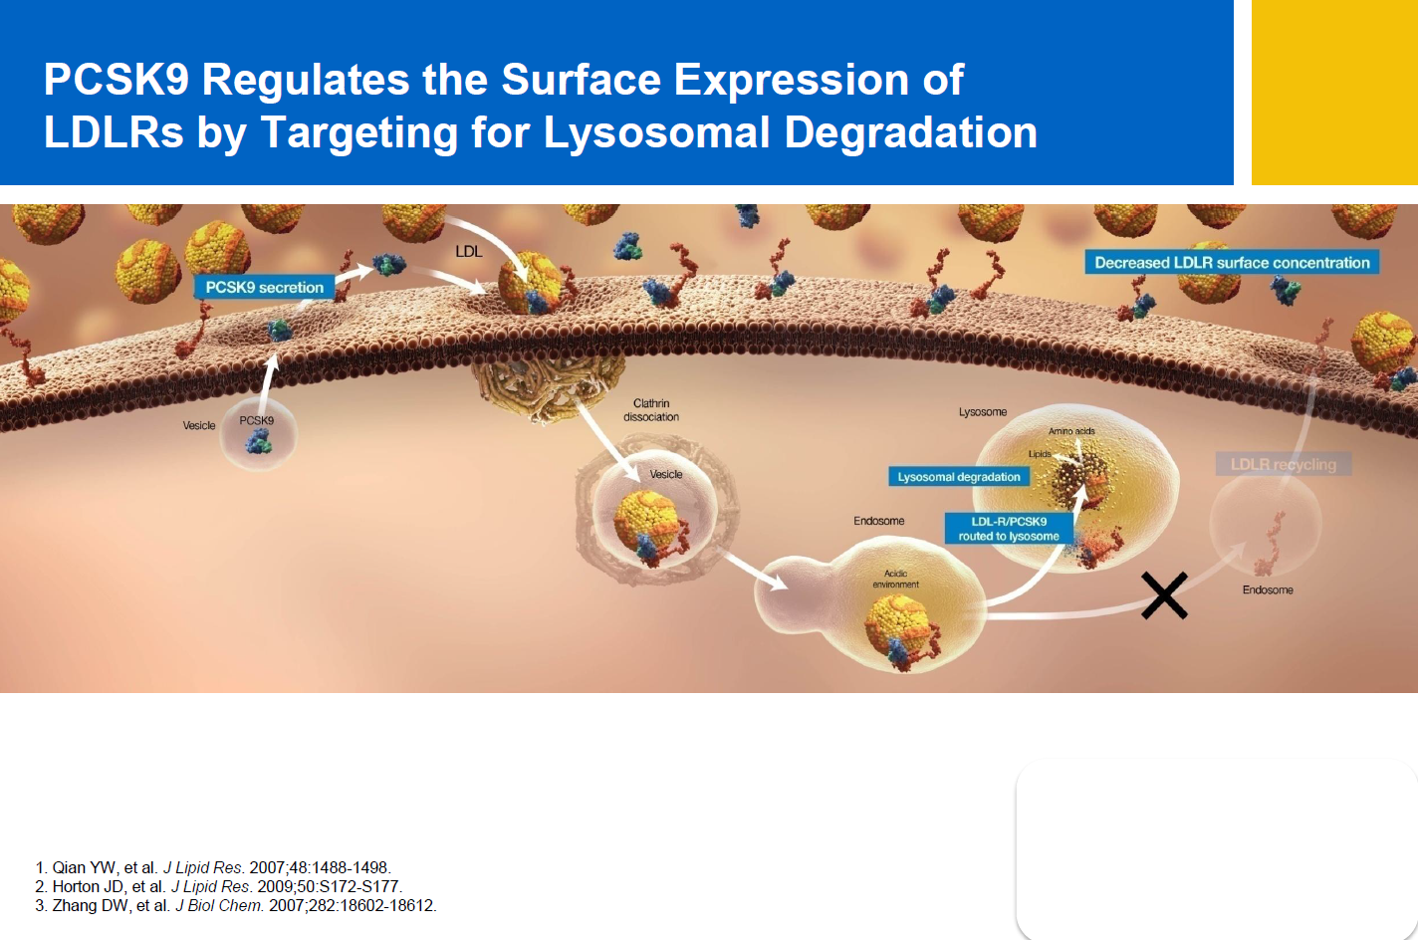

Slide 14
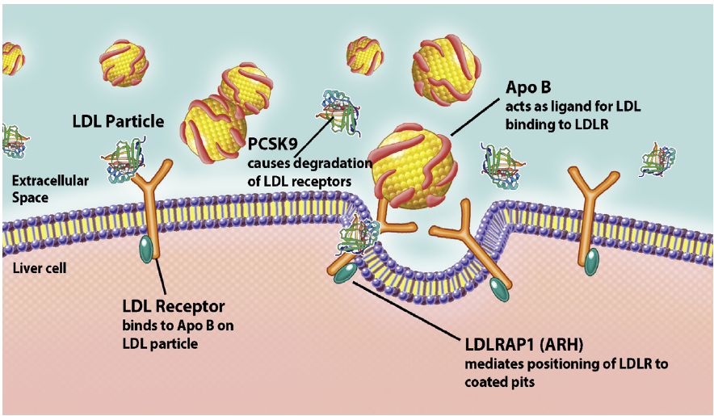

Slide 15
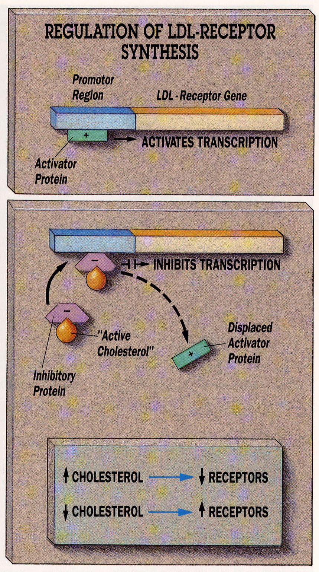

Slide 16
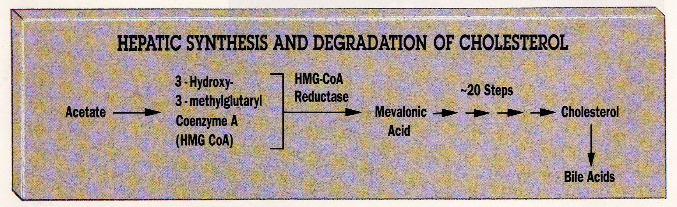

Slide 17
ΣΤΑΤΙΝΕΣ
⬇ χοληστερόλης των ηπατοκυττάρων
⬆ LDL υποδοχέων
⬇ LDL-C

Slide 18
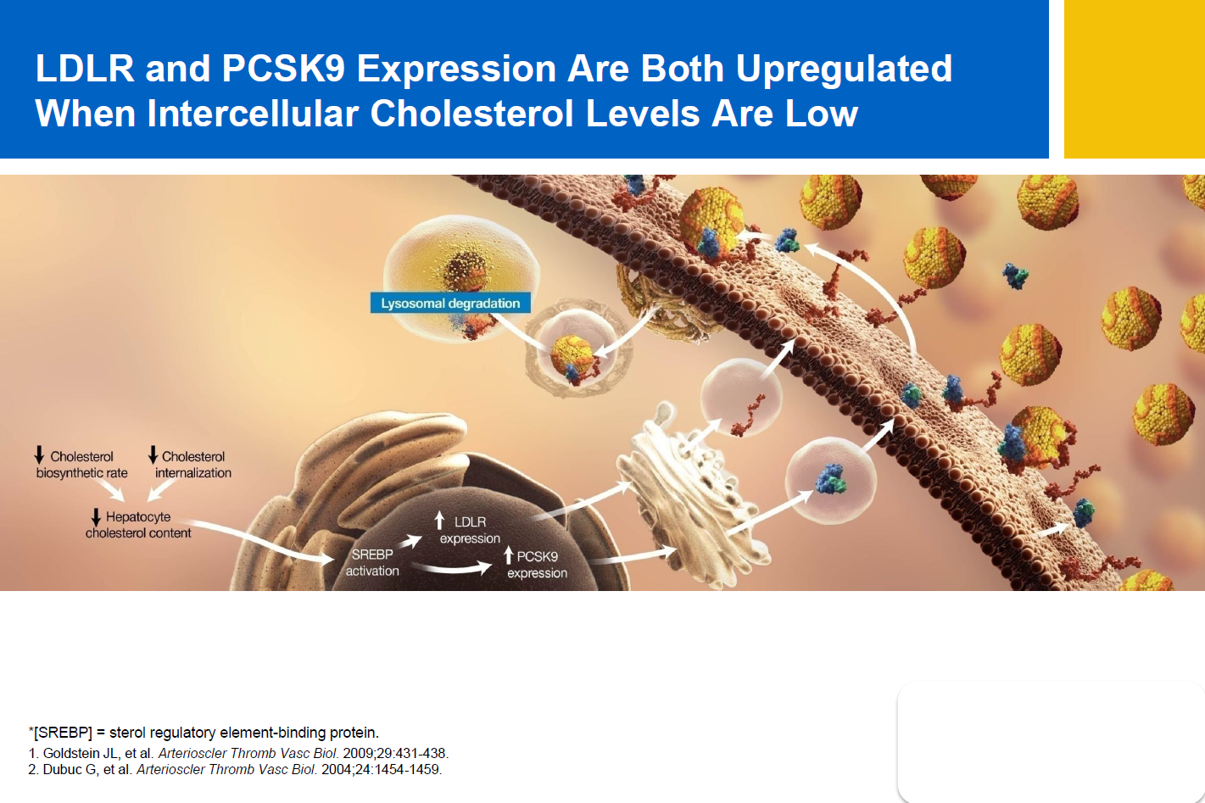

Slide 19
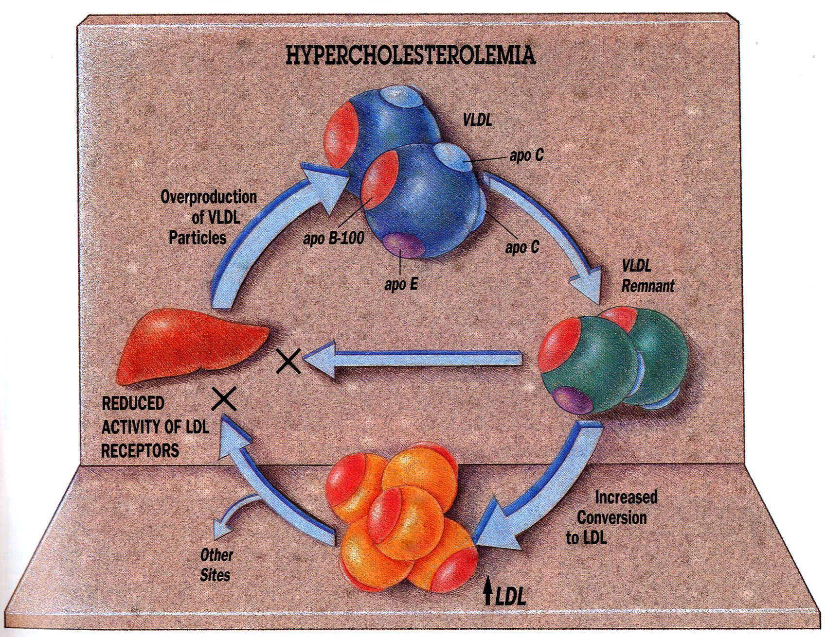

Slide 20
ΜΕΙΩΣΗ ΤΗΣ ΔΡΑΣΤΗΡΙΟΤΗΤΑΣ ΤΩΝ LDL ΥΠΟΔΟΧΕΩΝ
Γενετικοί παράγοντες (οικογενής υπερχοληστερολαιμία)
Περιβαλλοντικοί παράγοντες (παχυσαρκία / δίαιτα πλούσια σε ζωικά λίπη / υποθυρεοειδισμός)

Slide 21
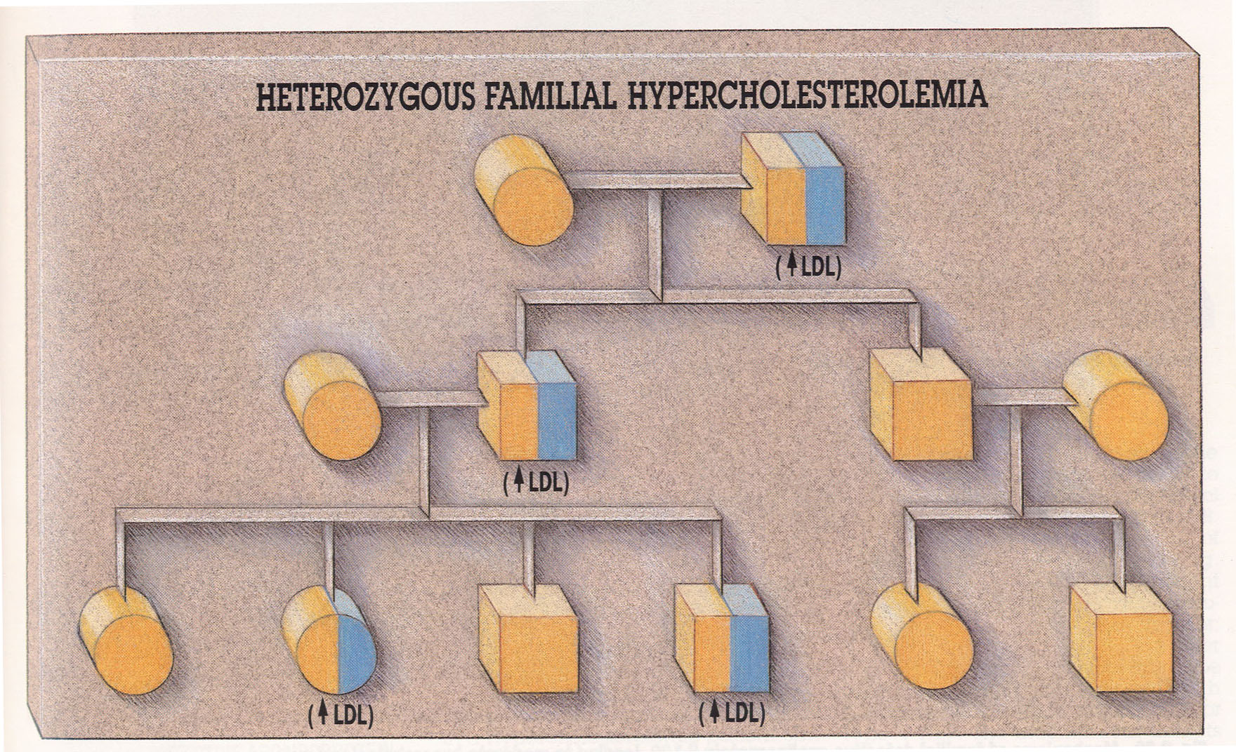

Slide 22
ΟΙΚΟΓΕΝΗΣ ΥΠΕΡΧΟΛΗΣΤΕΡΟΛΑΙΜΙΑ
⬇⬇ δραστηριότητας των LDL υποδοχέων
Η πιο συχνή γενετική διαταραχή (ετεροζυγώτες: 1/250 άτομα)
⬆⬆⬆ LDL CHOL
Πρώιμη αθηρωμάτωση

Slide 23
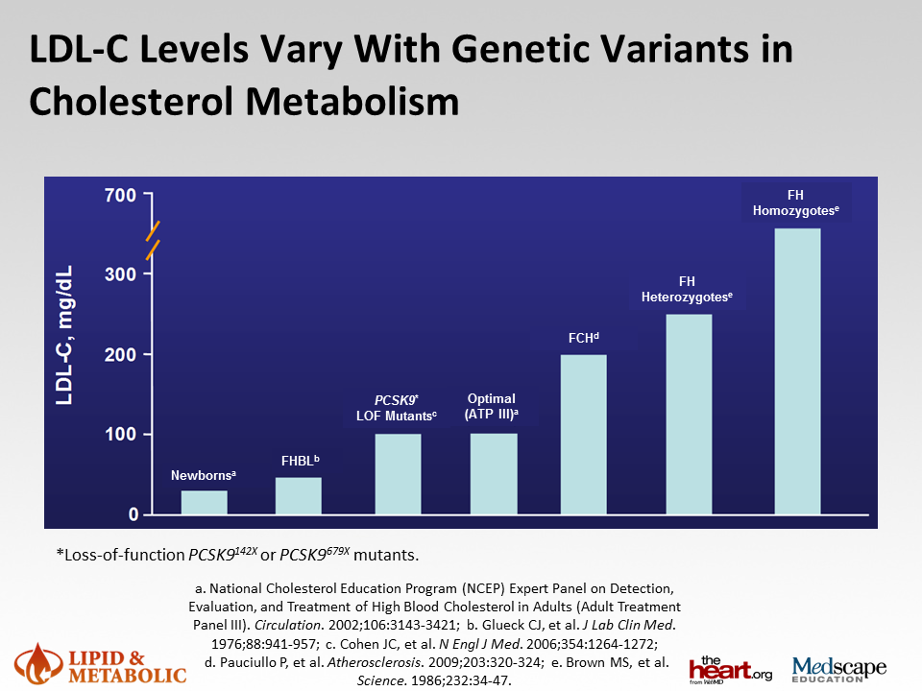

Slide 24
LDL-C concentrations and physical signs in untreated FH patients
>190 mg/dL
LDL-C Distribution in Untreated
Patients With Definite FH³
Cumulative Prevalence of Physical
Signs in Adult FH Patients³
Median = 6.95 mmol/L
(268.76 mg/dL)
Tendon xanthomas
Arcus cornealis
Xanthelasma
Mean = 7.22 mmol
(279.2 mg/dL)
100
75
Cumulative prevalence, %
Relative frequency
50
25
0
3.0
15
25
35
45
55
65
75
85
3.5
4.0
4.5
5.0
5.5
6.0
6.5
7.0
7.5
8.0
8.5
9.0
9.5
10.0
10.5
11.0
11.5
12.0
12.5
13.0
13.5
14.0
14.5
15.0
15.5
LDL-C (mmol/L) in untreated patients
Age (y)
1. Marais AD. Clin Biochem Rev. 2004;25(1):49-68.
2. Raal FJ, et al. Atherosclerosis. 2000;150(2):421-428.
3. Blom DJ, et al. S Afr Fam Pract. 2011;53(1):11-18.
Notes:
Absence of physical signs does not exclude the possibility of FH
•Presence of tendon xanthoma –almost assures diagnosis but insensitive
•Arcus, xanthelasma, tuberous xanthomas not generally useful.

Slide 25
The Netherland experience
Prevalence of HoFH higher than theoretical (~1:400.000)
Large variability in the phenotypes found
Phenotypic criteria of HoFH underestimate the actual number of HoADH patients
Actual number of HeFH, ~1:250
Huijgen et al Eur Heart J (2012) 33 (18): 2325-2330.

Slide 26
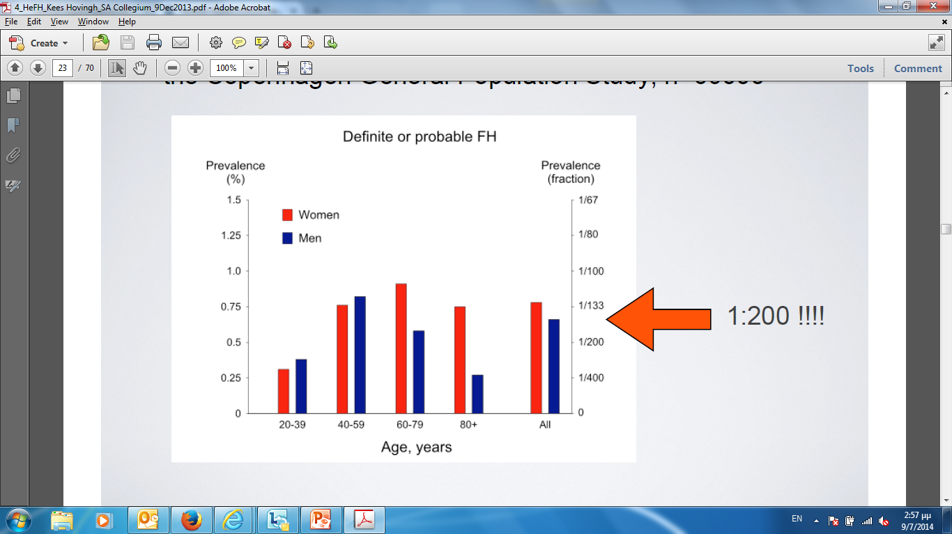
HeFH prevalence 1:500 true?
Data from the Copenhagen General Population Study, n=69.000
1:200 !!!
Data from Benn, M., et al. (2012) J Clin Endocrinol Metab 97(11): 3956-3964

Slide 27
HeFH PREVALENCE ~1/250
⬇
~40.000 patients in Greece!
HoFH PREVALENCE ~1/400.000
⬇
~25 patients in Greece

Slide 28
FH: Underdiagnosed?
Data from Nordestgaard, B. G., et al. (2013). Eur Heart J 34(45): 3478-3490a

Slide 29
FH: very high cholesterol levels from birth and threshold for CHD reached early in life
Cumulative exposure (cholesterol-years) by age: patients with FH vs healthy individuals
HoFH
HeFH
Normal
10
Female
Threshold for CHD
Male, hypertension
diabetes, smoking
Cumulative LDL-C exposure
(g/dl–year)
5
0
1
20
40
60
80
Age (years)
Threshold for CHD reached by:
  Age 15 years in patients with HoFH
  Age 40 years in patients with HeFH
  Age >60 years in healthy individuals
Adapted from Horton JD et al. J Lipid Res 2009;50(suppl):S172
Notes:
This slide compares the cumulative LDL exposure (expressed as grams of cholesterol per year) over a lifetime in FH patients and normal individuals. CHD occurs after a theoretical threshold of LDL exposure is exceeded (indicated by the red line. This threshold is reached in childhood in FH homozygotes, early middle age in FH heterozygotes and is significantly delayed in individuals who are heterozygous for PCSK9 loss-of-function mutations

Slide 30
FH: The “ghost” disease
Lipidologists
FH
Adults
Young age CHD patients
Children
Pediatricians
Cardiologists

Slide 31
ΟΙΚΟΓΕΝΗΣ ΥΠΕΡΧΟΛΗΣΤΕΡΟΛΑΙΜΙΑ
(ΕΤΕΡΟΖΥΓΩΤΕΣ)
Τενόντια ξανθώματα
Ξανθελάσματα
Γεροντότοξο

Slide 32
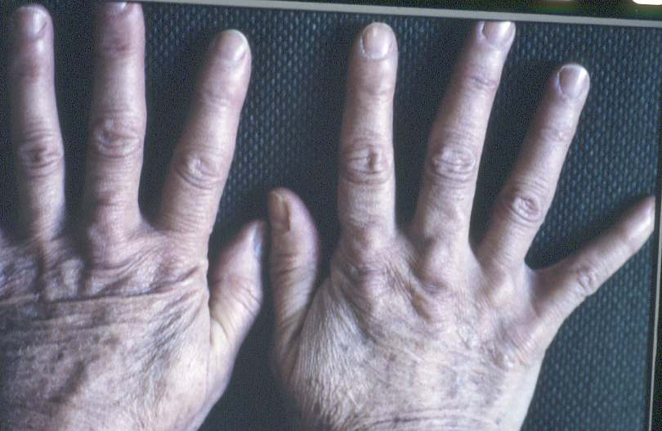

Slide 33
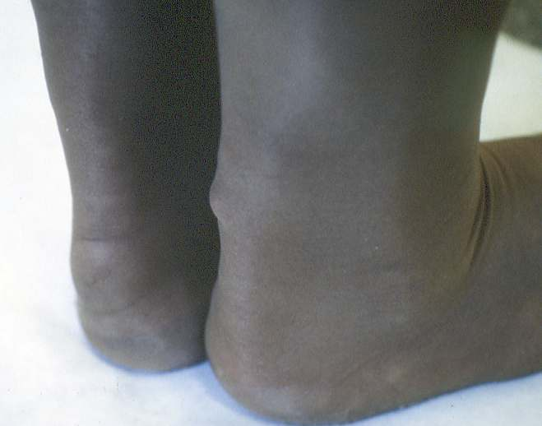

Slide 34
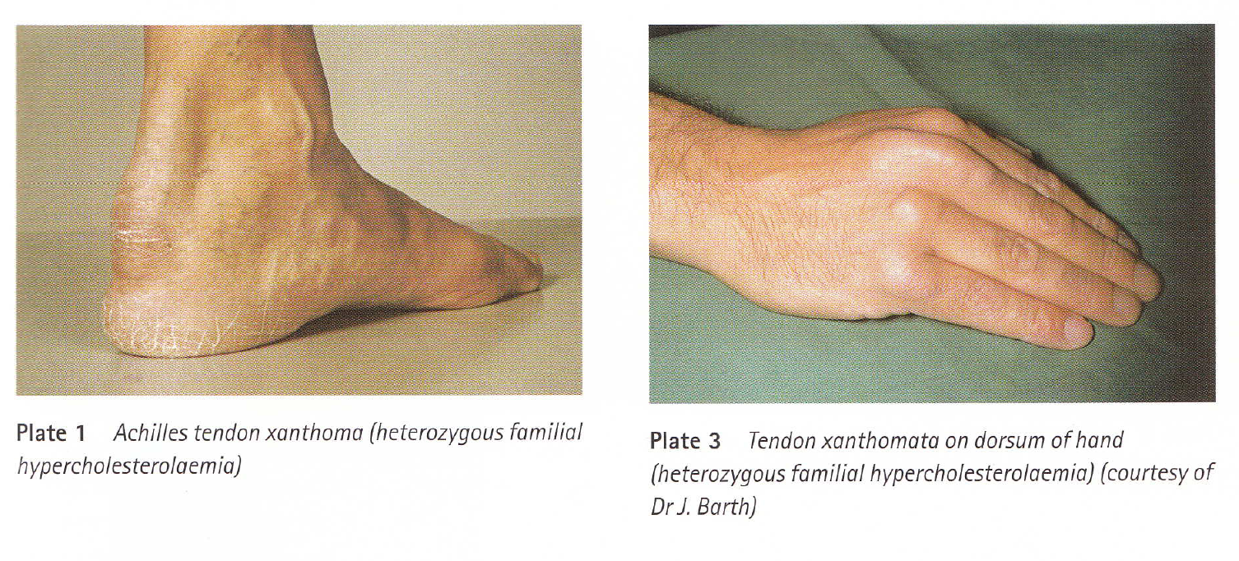

Slide 35
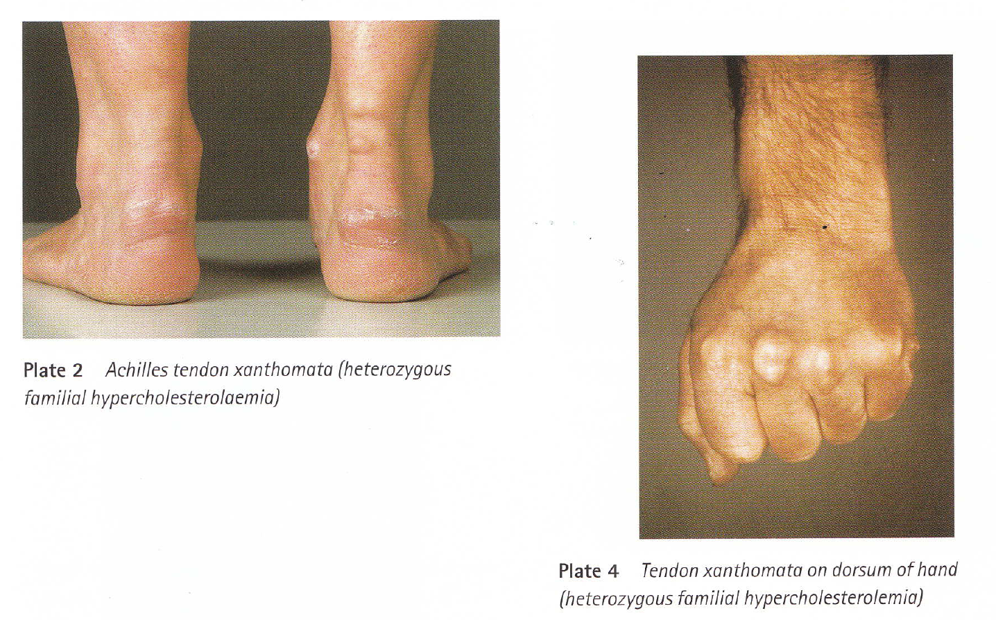

Slide 36
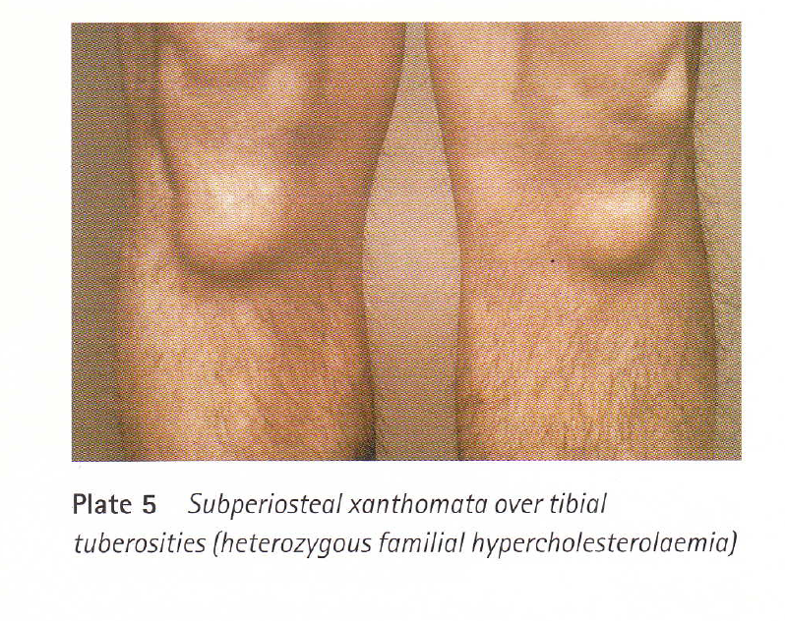

Slide 37
ΟΙΚΟΓΕΝΗΣ ΥΠΕΡΧΟΛΗΣΤΕΡΟΛΑΙΜΙΑ
(ΟΜΟΖΥΓΩΤΕΣ)
Τενόντια ξανθώματα
Υποδερματικά επίπεδα ή οζώδη ξανθώματα

Slide 38
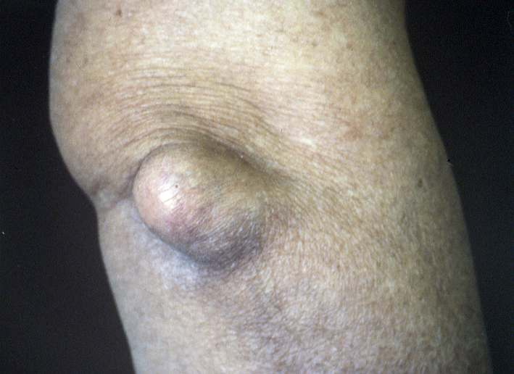

Slide 39
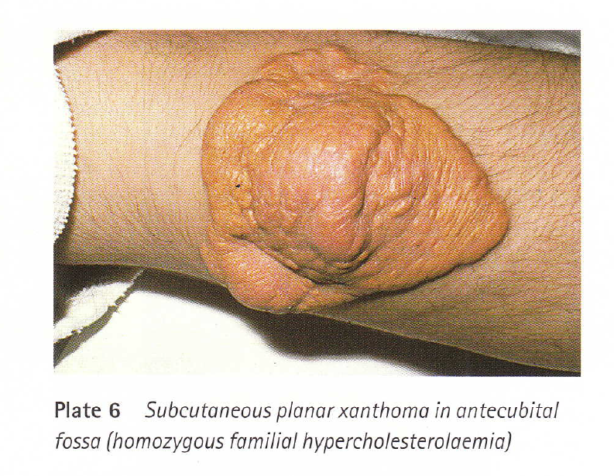

Slide 40
ΟΙΚΟΓΕΝΗΣ ΥΠΕΡΧΟΛΗΣΤΕΡΟΛΑΙΜΙΑ
(ΕΤΕΡΟΖΥΓΩΤΕΣ)
Τενόντια ξανθώματα
Ξανθελάσματα
Γεροντότοξο

Slide 41
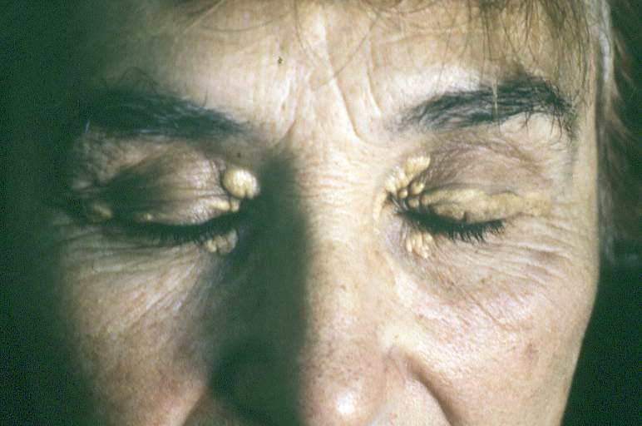

Slide 42
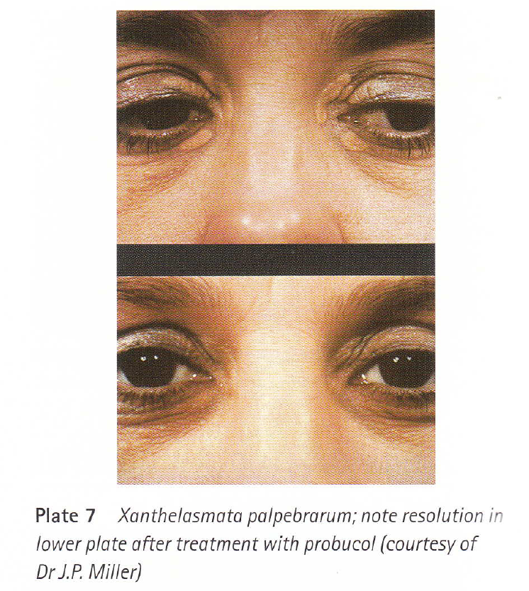

Slide 43
ΞΑΝΘΕΛΑΣΜΑΤΑ
Συχνά σε ασθενείς με υπερλιπιδαιμία (+οικογενή υπερχοληστερολαιμία)
Το 50% των ατόμων με ξανθελάσματα έχουν φυσιολογικά επίπεδα T CHOL και TRG

Slide 44
ΟΙΚΟΓΕΝΗΣ ΥΠΕΡΧΟΛΗΣΤΕΡΟΛΑΙΜΙΑ
(ΕΤΕΡΟΖΥΓΩΤΕΣ)
Τενόντια ξανθώματα
Ξανθελάσματα
Γεροντότοξο

Slide 45
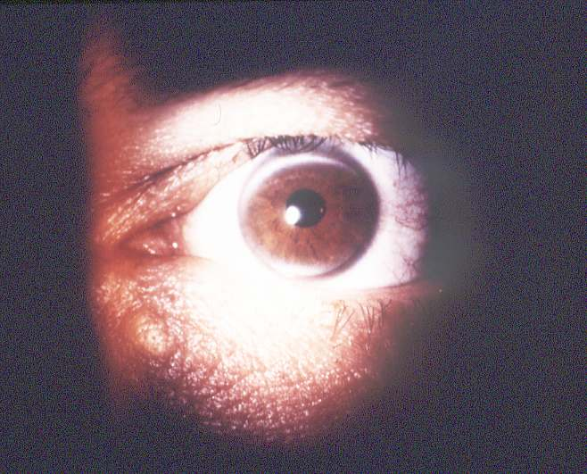

Slide 46
ΓΕΡΟΝΤΟΤΟΞΟ ΣΕ ΝΕΑΡΑ ΑΤΟΜΑ
Οικογενής υπερχοληστερολαιμία

Slide 47
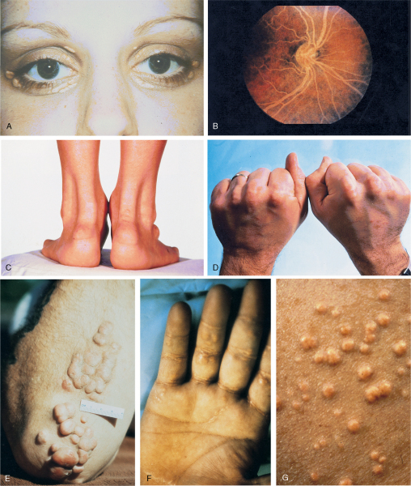
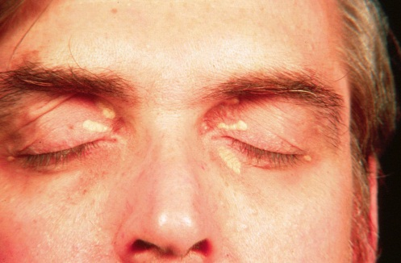
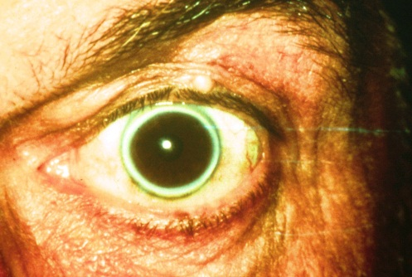
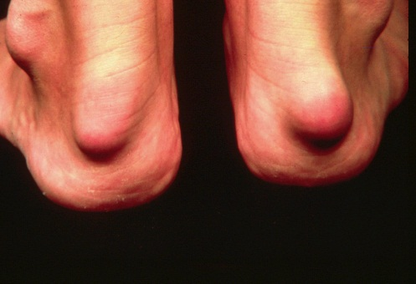
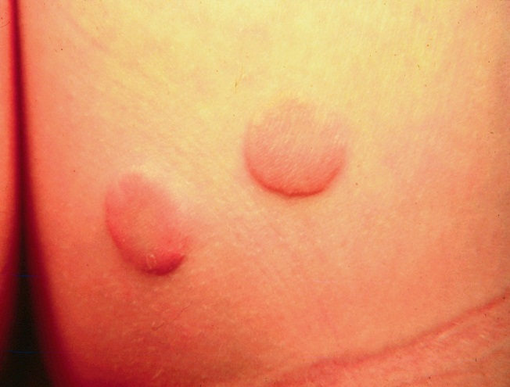
Clinical Presentation of HoFH / Severe FH
Xanthelasma
Corneal arcus
Achilles tendon xanthomas
Tendon xanthomas
Tuberous xanthomas
Planar xanthomas—HoFH
A
B
C
D
E
F
Mahley RW et al. In Kronenberg. Williams Textbook of Endocrinology. 2008.
Notes:
Approximately 30% to 50% of HeFH patients with genetic diagnosis have TX.^{2,3,4}
47

Slide 48
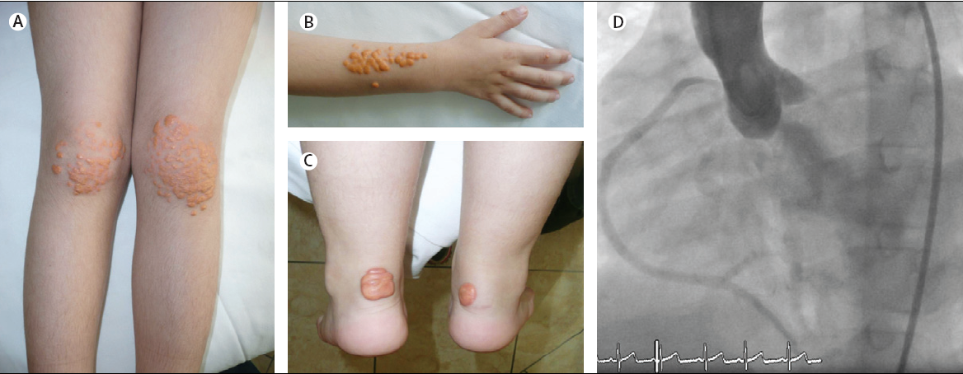

Slide 49
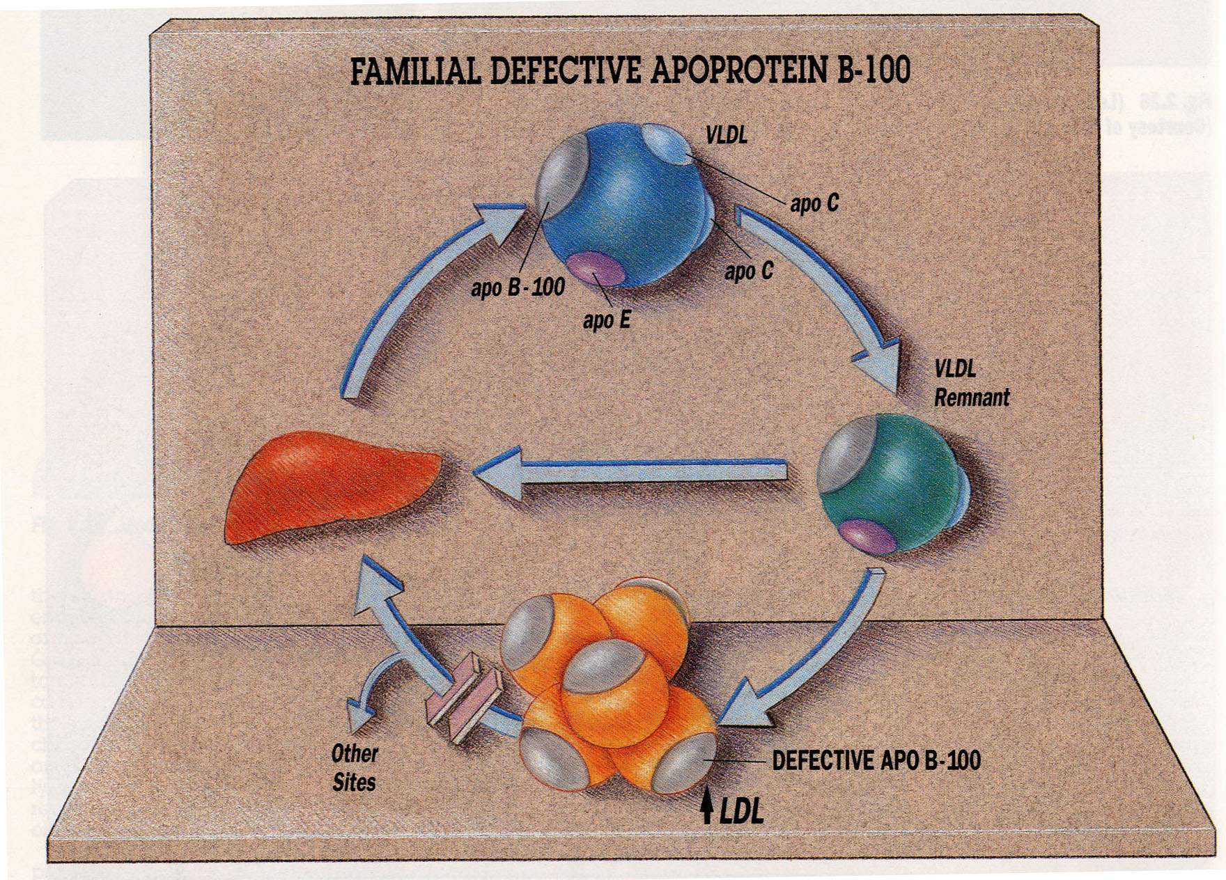

Slide 50
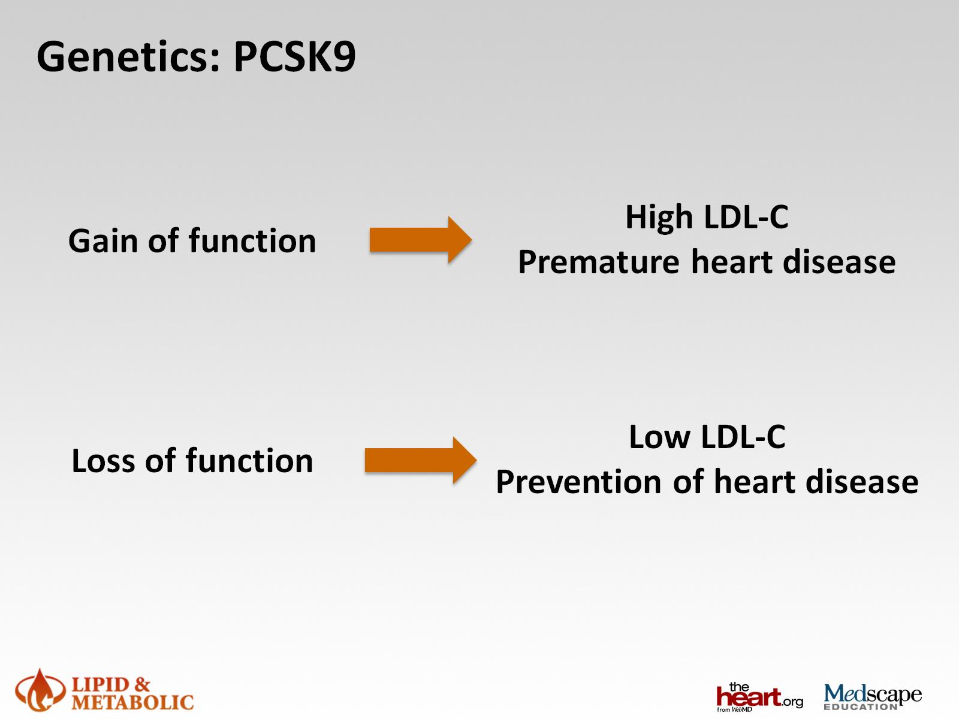
Genetics: PCSK9

Slide 51
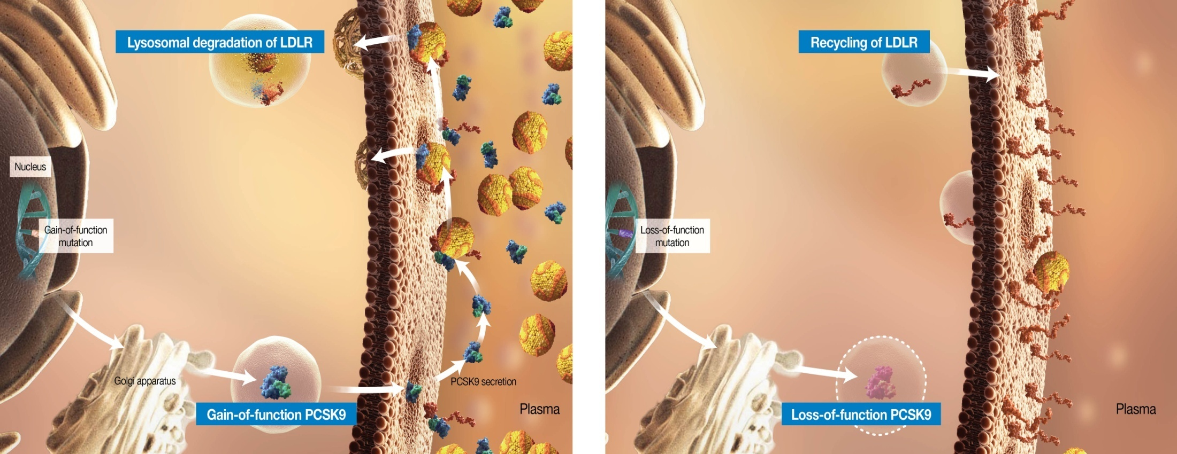
Genetic Variants of PCSK9 Demonstrate Its Importance in Regulating LDL Levels
PCSK9 Gain of Function (GOF) =
Less LDL-Rs^{1,3,5}
PCSK9 Loss of Function (LOF) =
More LDL-Rs^{2,4,5}
  Mutations in the human PCSK9 gene that lead to a loss of PCSK9 function are found
  in 1% to 3% of the population^{6,7}
1. Horton JD, et al. J Lipid Res. 2009;50:S172-S177. 2. Lakoski SG, et al. J Clin Endocrinol Metab. 2009;94:
2537-2543. 3. Abifadel M, et al. Hum Mutat. 2009;30:520-529. 4. Cohen J, et al. Nat Genet. 2005;37:161-165.
5. Steinberg D, et al. PNAS. 2009;106:9546-9547. 6. Cohen JC, et al. N Engl J Med. 2006;354:1264-1272.
7. Benn M, et al. J Am Coll Cardiol. 2010;55:2833-2842.
Notes:
Key Points
The role of PCSK9 in the regulation of plasma LDL levels is supported by a significant amount of genetic evidence.¹
Gain-of-function (GOF) mutations in PCSK9 result in increased PCSK9 function, which leads to decreased LDL-R recycling to the cell surface. This results in an autosomal dominant hypercholesterolemia with increased plasma LDL levels and increased risk of developing coronary heart disease (CHD).^{1,2}
Mutations in the human PCSK9 gene that lead to a loss of PCSK9 function are found in 1% to 3% of the population.^{3,4} These loss-of-function (LOF) mutations are associated with lower levels of circulating PCSK9,⁵ lower plasma LDL levels, and a lower incidence of CHD,³ suggesting that inhibiting the interaction between PCSK9 and LDL-Rs may lower plasma LDL levels.⁶
Horton JD, Cohen JC, Hobbs HH. PCSK9: a convertase that coordinates LDL catabolism. J Lipid Res. 2009;50:S172-S177.
Abifadel M, Rabès JP, Devillers M, et al. Mutations and polymorphisms in the proprotein convertase subtilisin kexin 9 (PCSK9) gene in cholesterol metabolism and disease. Hum Mutat. 2009;30:520-529.
Cohen JC, Boerwinkle E, Mosley TH Jr, Hobbs HH. Sequence variations in PCSK9, low LDL, and protection against coronary heart disease. N Engl J Med. 2006;354:1264-1272.
Benn M, Nordestgaard BG, Grande P, Schnohr P, Tybjaerg-Hansen A. PCSK9 R46L, low-density lipoprotein cholesterol levels, and risk of ischemic heart disease: 3 independent studies and meta-analyses. J Am Coll Cardiol. 2010;55:2833-2842.
Lakoski SG, Lagace TA, Cohen JC, Horton JD, Hobbs HH. Genetic and metabolic determinants of plasma PCSK9 levels. J Clin Endocrinol Metab. 2009;94:2537-2543.
Cohen J, Pertsemlidis A, Kotowski IK, Graham R, Garcia CK, Hobbs HH. Low LDL cholesterol in individuals of African descent resulting from frequent nonsense mutations in PCSK9. Nat Genet. 2005;37:161-165.

Slide 52
Clinical Outcomes Associated With
PCSK9 GOF Mutations
ADH caused by rare PCSK9 GOF mutations
have a clinical phenotype resembling FH
caused by LDL-R or apoB gene mutations^{1,2}
ADH-associated physical abnormalities¹
Stroke¹
Coronary heart disease (CHD)^{1,2}
Premature myocardial infarction (MI)¹
1. Abifadel M, et al. In: Toth PP. The Year in Lipid Disorders. Vol. 2. Oxford, UK: Atlas Medical Publishing Ltd. 2010:3-23.
  2. Benn M, et al. J Am College Cardiol. 2010;55:2833-2842.
Notes:
Key Point
PCSK9 GOF mutations are associated with a clinical phenotype that is similar to FH caused by mutations in the LDL-R and apoB genes. Individuals may be at an increased risk for certain CV events such as CHD, premature myocardial infarction (MI), or stroke.¹
Abifadel M, Boileau C. Proprotein convertase subtilisin/kexin type 9 (PCSK9): molecular function and impact of its mutations and polymorphisms on cholesterol levels and related diseases. In: Toth PP. The Year in Lipid Disorders. Vol. 2. Oxford, UK: Atlas Medical Publishing Ltd. 2010:3-23.

Slide 53
Genetic Variants of PCSK9 Demonstrate Its Importance in Regulating LDL Levels
PCSK9 Gain of Function (GOF) =
Less LDL-Rs^{1,3,5}
PCSK9 Loss of Function (LOF) =
More LDL-Rs^{2,4,5}
  Mutations in the human PCSK9 gene that lead to a loss of PCSK9 function are found
  in 1% to 3% of the population^{6,7}
1. Horton JD, et al. J Lipid Res. 2009;50:S172-S177. 2. Lakoski SG, et al. J Clin Endocrinol Metab. 2009;94:
2537-2543. 3. Abifadel M, et al. Hum Mutat. 2009;30:520-529. 4. Cohen J, et al. Nat Genet. 2005;37:161-165.
5. Steinberg D, et al. PNAS. 2009;106:9546-9547. 6. Cohen JC, et al. N Engl J Med. 2006;354:1264-1272.
7. Benn M, et al. J Am Coll Cardiol. 2010;55:2833-2842.
Notes:
Key Points
The role of PCSK9 in the regulation of plasma LDL levels is supported by a significant amount of genetic evidence.¹
Gain-of-function (GOF) mutations in PCSK9 result in increased PCSK9 function, which leads to decreased LDL-R recycling to the cell surface. This results in an autosomal dominant hypercholesterolemia with increased plasma LDL levels and increased risk of developing coronary heart disease (CHD).^{1,2}
Mutations in the human PCSK9 gene that lead to a loss of PCSK9 function are found in 1% to 3% of the population.^{3,4} These loss-of-function (LOF) mutations are associated with lower levels of circulating PCSK9,⁵ lower plasma LDL levels, and a lower incidence of CHD,³ suggesting that inhibiting the interaction between PCSK9 and LDL-Rs may lower plasma LDL levels.⁶
Horton JD, Cohen JC, Hobbs HH. PCSK9: a convertase that coordinates LDL catabolism. J Lipid Res. 2009;50:S172-S177.
Abifadel M, Rabès JP, Devillers M, et al. Mutations and polymorphisms in the proprotein convertase subtilisin kexin 9 (PCSK9) gene in cholesterol metabolism and disease. Hum Mutat. 2009;30:520-529.
Cohen JC, Boerwinkle E, Mosley TH Jr, Hobbs HH. Sequence variations in PCSK9, low LDL, and protection against coronary heart disease. N Engl J Med. 2006;354:1264-1272.
Benn M, Nordestgaard BG, Grande P, Schnohr P, Tybjaerg-Hansen A. PCSK9 R46L, low-density lipoprotein cholesterol levels, and risk of ischemic heart disease: 3 independent studies and meta-analyses. J Am Coll Cardiol. 2010;55:2833-2842.
Lakoski SG, Lagace TA, Cohen JC, Horton JD, Hobbs HH. Genetic and metabolic determinants of plasma PCSK9 levels. J Clin Endocrinol Metab. 2009;94:2537-2543.
Cohen J, Pertsemlidis A, Kotowski IK, Graham R, Garcia CK, Hobbs HH. Low LDL cholesterol in individuals of African descent resulting from frequent nonsense mutations in PCSK9. Nat Genet. 2005;37:161-165.

Slide 54
Clinical Outcomes Associated With
PCSK9 LOF Mutations
Missense PCSK9 LOF mutations
in families with hypocholesterolemia
reported in global population studies^{1,2}
Reduced plasma
levels of TC
and LDL-C^{1,3,4}
Protection from CHD^{1,3}
Reduced risk of early-onset MI⁵
1. Abifadel M, et al. Hum Mutat. 2009;30:520-529. 2. Abifadel M, et al. Hum Mutat. 2009;30: supplementary information. 3. Abifadel M, et al. In: Toth PP. The Year in Lipid Disorders. Vol. 2. Oxford, UK: Atlas Medical Publishing Ltd. 2010:3-23. 4. Benn M, et al. J Am Coll Cardiol. 2010;55:2833:2842. 5. Kathiresan S. N Engl J Med. 2008;358:2299-2300.
Notes:
Key Point
Missense LOF mutations associated with hypocholesterolemia have been reported in global population studies and are associated with reductions in plasma levels of TC and LDL-C, protection from CHD, and reduced risk of early-onset MI.¹⁻⁵
Abifadel M, Rabès JP, Devillers M, et al. Mutations and polymorphisms in the proprotein convertase subtilisin kexin 9 (PCSK9) gene in cholesterol metabolism and disease. Hum Mutat. 2009;30:520-529.
Abifadel M, Rabès JP, Devillers M, et al. Mutations and polymorphisms in the proprotein convertase subtilisin kexin 9 (PCSK9) gene in cholesterol metabolism and disease. Hum Mutat. 2009;30: supplementary information.
Abifadel M, Boileau C. Proprotein convertase subtilisin/kexin type 9 (PCSK9): molecular function and impact of its mutations and polymorphisms on cholesterol levels and related diseases. In: Toth PP. The Year in Lipid Disorders. Vol. 2. Oxford, UK: Atlas Medical Publishing Ltd. 2010:3-23.
Benn M, Nordestgaard BG, Grande P, Schnohr P, Tybjaerg-Hansen A. PCSK9 R46L, low-density lipoprotein cholesterol levels, and risk of ischemic heart disease. J Am Coll Cardiol. 2010;55:2833-2842.
Kathiresan S. A PCSK9 missense variant associated with a reduced risk of early-onset myocardial infarction. N Engl J Med. 2008:358:2299-2300.

Slide 55
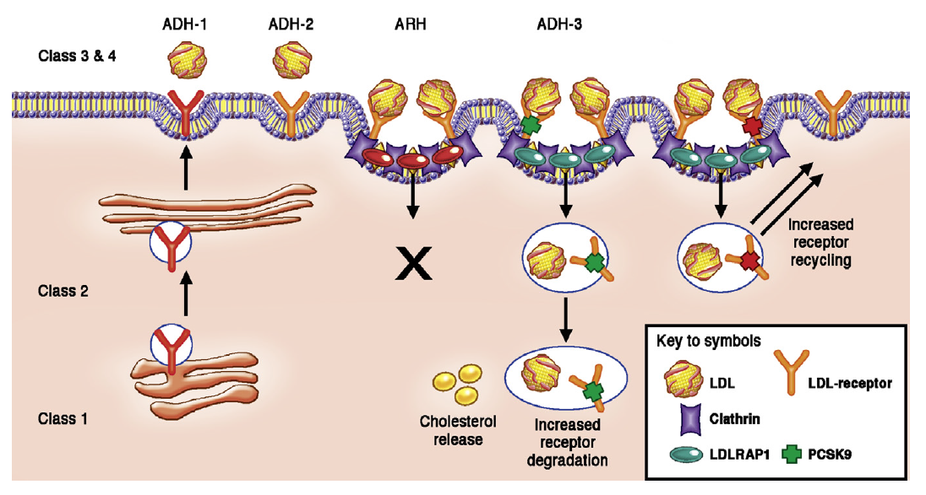

Slide 56

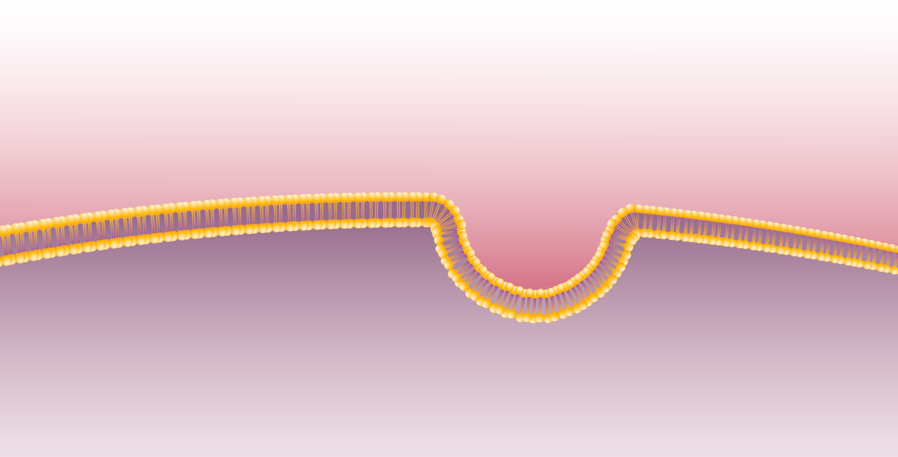





FH can be caused by mutations in 4 known genes
FH is typically caused by mutations in LDLR, ApoB, PCSK9,
LDLRAP1 or other as yet other unidentified genes¹
Apo B
acts as ligand, binding LDL particle to receptor
LDL Particle
Circulation
Liver cell
LDL Receptor
on hepatocyte, binds to Apo B on LDL particle, inducing endocytosis of LDL
LDLRAP1 (ARH)
mediates internalization via clathrin coated pits
PCSK9 Enzyme
degrades LDL receptors
Image reproduced from http://www.dls.ym.edu.tw/ol_biology2/ultranet/Endocytosis.html.
1. De Castro-Oros I, et al. Appl Clin Genet. 2010;3:53-64.
Notes:
In addition to the 3 most well-known mutations, there are additional unidentified gene mutations in new loci that can cause FH or Autosomal Dominant Hypercholesterolemia (ADH)
1 - Cenarro A et al Clin Genet 2011: 79: 475–481 A presumptive new locus for autosomal dominant hypercholesterolemia mapping to 8q24.22
2 - Alice Marques-Pinheiro et al , European Journal of Human Genetics (2010) 18, 1236–1242 A fourth locus for autosomal dominant hypercholesterolemia maps at 16q22.1
56

Slide 57
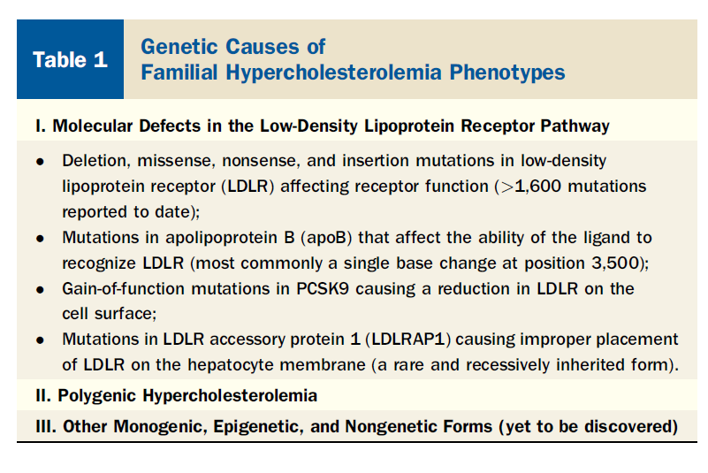

Slide 58
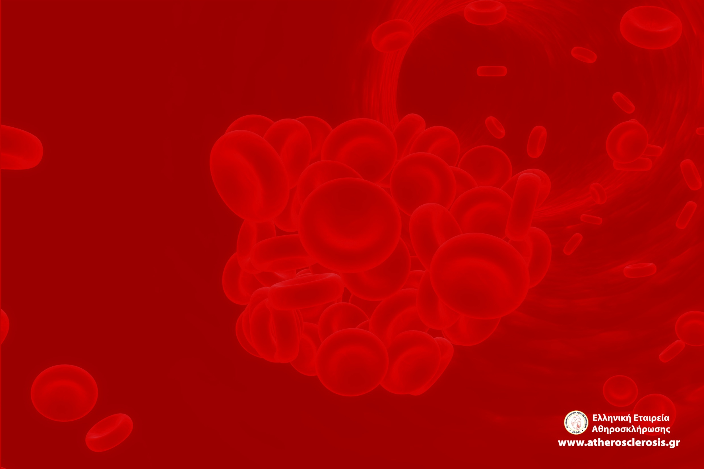
Dutch Lipid Clinic Network κριτήρια για τη διάγνωση της ετερόζυγου οικογενούς υπερχοληστερολαιμίας
Κριτήρια |  | Score
Οικογενειακό Ιστορικό | 1^{ου} βαθμού συγγενείς με:
 | Πρώιμη στεφανιαία ή αγγειακή νόσος (άνδρες <55 ετών; γυναίκες <60 ετών) | 1
 | LDL χοληστερόλη > 95^{ο} εκατοστημόριο για το φύλο και την ηλικία | 1
 | Τενόντια ξανθώματα ή/και γεροντότοξο | 2
 | 1^{ου} βαθμού συγγενείς <18 ετών με LDL χοληστερόλη >95^{ο} εκατοστημόριο για το φύλο και την ηλικία | 2
Ατομικό ιστορικό | Ασθενής με ιστορικό πρώιμης στεφανιαίας νόσου (ηλικίες όπως αναφέρθηκαν παραπάνω) | 2
 | Ασθενής με ιστορικό πρώιμης περιφερειακής αγγειακής νόσου ή ισχαιμικού αγγειακού εγκεφαλικού επεισοδίου (ηλικίες όπως αναφέρθηκαν παραπάνω) | 1
Φυσική εξέταση | Τενόντια ξανθώματα | 6
 | Γεροντότοξο σε ηλικία κάτω των 45 ετών | 4
Εργαστηριακός έλεγχος | LDL χοληστερόλη, mg/dL (mmol/L)
 | 330 (≥8.5) | 8
 | 250-330 (6.5-8.4) | 5
 | 190-250 (5.0-6.4) | 3
 | 159-190 (4.0-4.9) | 1
DNA ανάλυση | Αποτελέσματα γενετικού ελέγχου που επιβεβαιώνουν λειτουργική μετάλλαξη στα γονίδια του LDL υποδοχέα, της απολιποπρωτεϊνης Β ή της PCSK9 | 8
Συνολικό score | Διάγνωση
≥8 | Βέβαιη οικογενής υπερχοληστερολαιμία
6-7 | Πολύ πιθανή οικογενής υπερχοληστερολαιμία
3-5 | Πιθανή οικογενής υπερχοληστερολαιμία
Hellenic Journal of Atherosclerosis 2014;5(3): 151-163

Slide 59
ΟΙΚΟΓΕΝΗΣ ΥΠΕΡΧΟΛΗΣΤΕΡΟΛΑΙΜΙΑ-ΘΕΡΑΠΕΙΑ
Στατίνες (υψηλές δόσεις)
+ Ezetimibe/κολεσεβελάμη

Slide 60
ΑΣΘΕΝΗΣ ΜΕ ΟΙΚΟΓΕΝΗ ΥΠΕΡΧΟΛΗΣΤΕΡΟΛΑΙΜΙΑ
⬆⬆⬆⬆ LDL CHOL (από την εμβρυϊκή ζωή)
ΑΤΟΜΟ ΥΨΗΛΟΥ ΚΙΝΔΥΝΟΥ
ΕΠΙΘΕΤΙΚΗ ΑΝΤΙΜΕΤΩΠΙΣΗ
(LDL CHOL <100 mg/dL)

Slide 61
ROSUVASTATIN 40 mg
+
EZETIMIBE 10 mg
+
COLESEVELAM 3.75 g

Slide 62
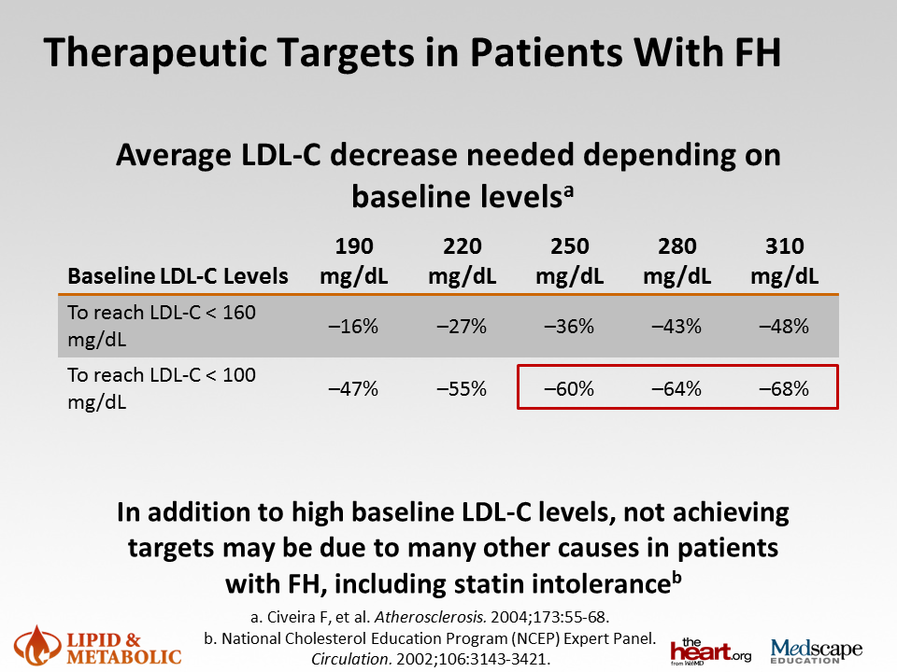

Slide 63
Current cholesterol lowering drugs are insufficient in HoFH
Class | Major Effect | Typical LDL-C-Lowering Response
Statins (e.g. atorvastatin, rosuvastatin) | ↑ LDLR activity | <10 to 25%
Bile acid sequestrants (e.g. cholestyamine, colestipol) | ↑ LDLR activity | <10%
Cholesterol absorption inhibitors (e.g. ezetimibe ) | ↑ LDLR activity | <10%
Nicotinic acid (i.e. niacin) | Unknown | <10%
Rader DJ, et al. J Clin Invest. 2003;111:1796-1803. Konrad RJ, et al. Lipids Health Dis. 2011;10:38.

Slide 64
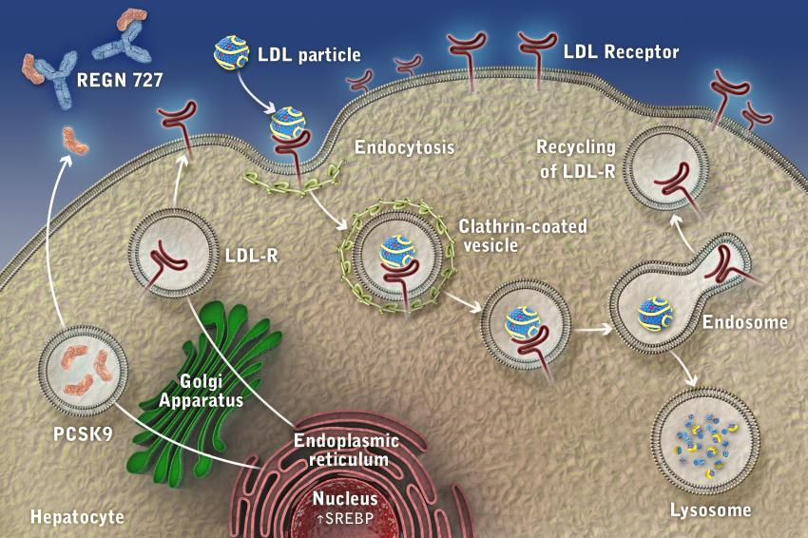
Impact of an PCSK9 mAb on LDL Receptor Expression
For illustration purposes only
mAb
64

Slide 65
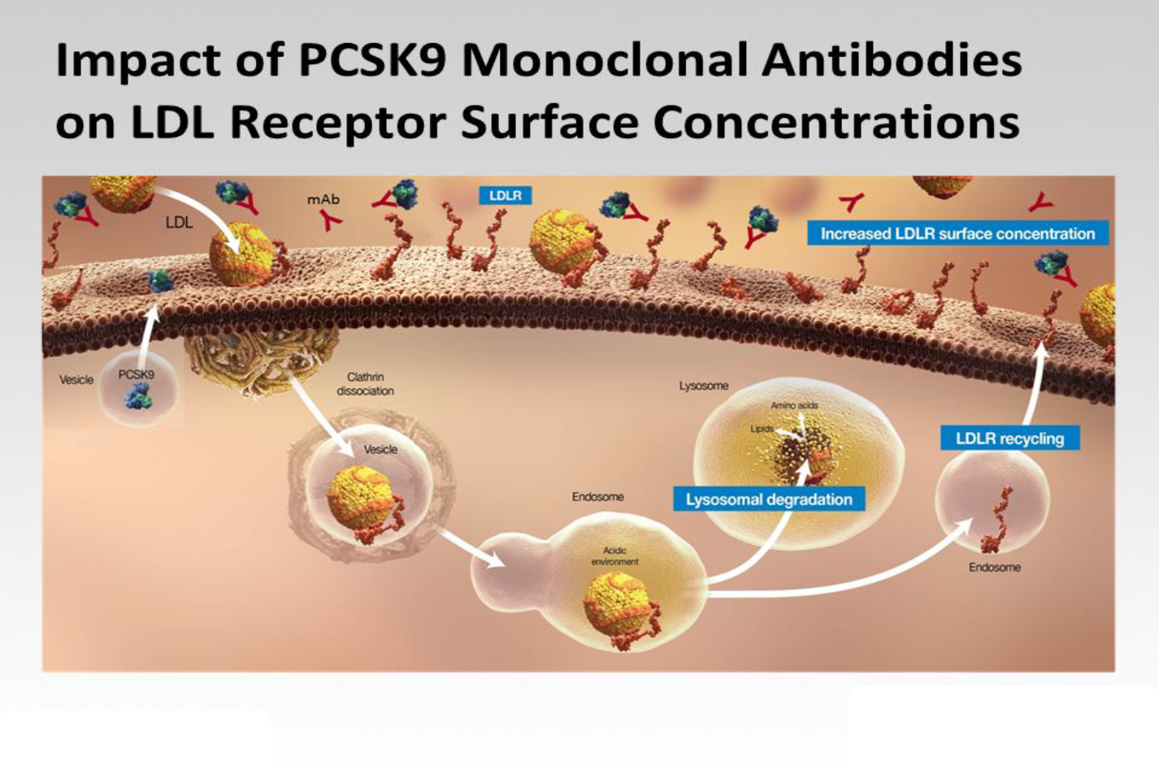

Slide 66

PCSK9:
Rapid Progress From Discovery to Clinic
Adenoviral ⬆ expression in mice
PCSK9 KO mouse ⬇ LDL-C
PCSK9 LOF mutations found with 28% ⬇ LDL-C
and 88% ⬇ CHD risk
Humans null for PCSK9 have LDL-C ~15 mg/dL
First subject treated with PCSK9 mAb
PCSK9 (NARC-1) discovered
PCSK9 GOF mutations associated with ADH
First patients with FH & nonFH treated with PCSK9 mAb
Plasma PCSK9 binds to LDLr
⬇ LDL-C in mice and non-human primates treated with anti-PCSK9 mAb
First publication POC in patients
2000 2001 2002 2003 2004 2005 2006 2007 2008 2009 2010 2012
Seidah NG. Proc Natl Acad Sci USA 2003;100(3):928-33, Abifadel M. Nat Genet 2003;34(2):154-6, Maxwell KN. Proc Natl Acad Sci USA 2004;101(18):7100-5, Rashid S. Proc Natl Acad Sci USA 2005;102(15):5374-79, Lagace TA et al. JCI 2006;116:2995-3005 Cohen JC. N Engl J Med 2006;354(12):1264-72, Zhao Z. Am J Hum Genet 2006;79(3):514-23, Hooper AJ. Atherosclerosis 2007;193(2):445-8, Chan JC. Proc Natl Acad Sci USA 2009;106(24):9820-5; Stein et al N Engl J Med 2012;366:1108-18

Slide 67
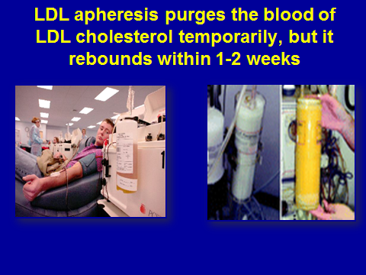
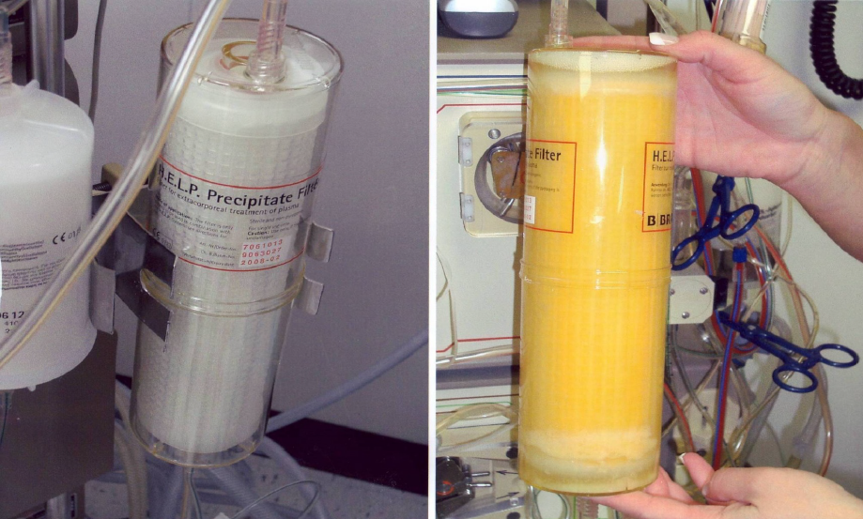
LDL apheresis is current standard of care for HoFH
CM-016

Slide 68
LDL-C Levels acutely decrease and then rebound following apheresis
Start of LDL apheresis
In a cohort of 7 patients with HoFH, lipid lowering therapies and once weekly apheresis reduced LDL-C to
  Pre-apheresis - 5.1 mmol/l
  Post apheresis - 2.2 mmol/l
  Mean interval - 4.2 mmol/l
Baseline
LDL
Pre-treatment
LDL level
LDL cholesterol
2-week interval
Post-treatment
LDL level
Time
1. Thomson et al. Atherosclerosis 2010, 208: 317-321. 2. Graesdal et al. J Clin Lipidology 2012, 6:331-339
Notes:
Immediately following LDL apheresis, LDL-C levels are acutely reduced. There is then a rebound that over 1-2 weeks comes back to baseline. LDL-C levels in patients on LDL apheresis are measured immediately prior to the procedure. Importantly, in hoFH the pre-apheresis LDL-C level is generally still very elevated. Thus LDL apheresis, while having some benefit, does not adequately treat the markedly elevated LDL-C levels in in hoFH.

Slide 69
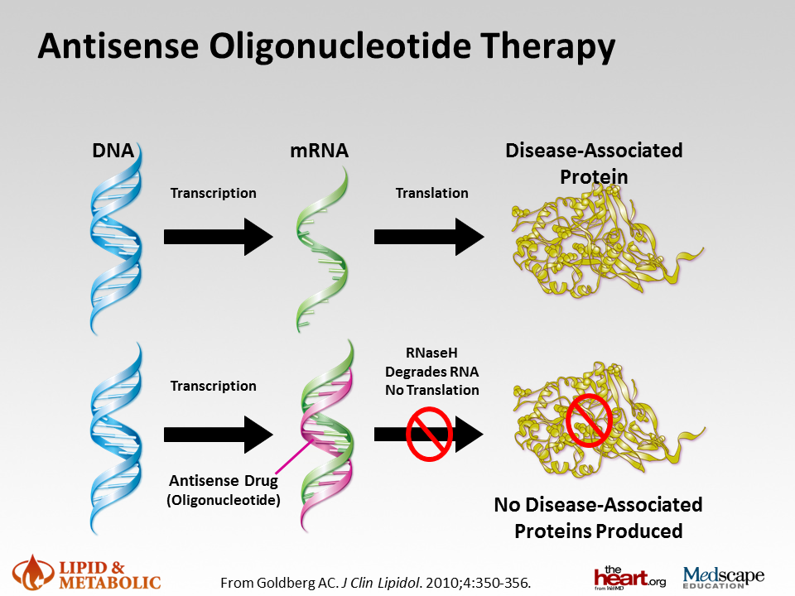

Slide 70
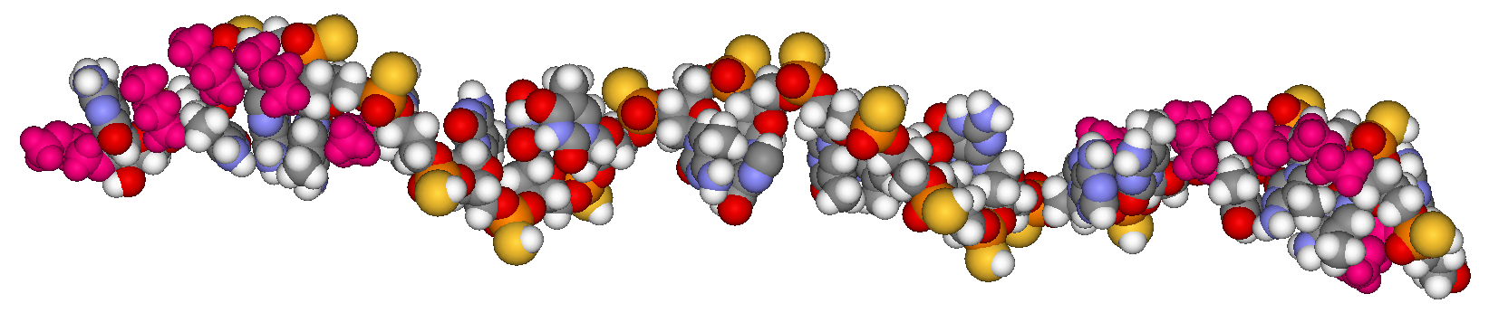
Mipomersen – A 2nd Generation Antisense Drug
5’-wing
gap
3’-wing
‘Gapmer’ design
(to activate RNase H)
  MOE modification
  at ends
  DNA in middle
  Phosphorothioate
  throughout
  20 bases for high
  specificity and affinity
Molecular model of mipomersen
G C C T C
A G T C T G C T T C
G C A C C
MOE
DNA
MOE
Phosphorothioate linkage
MOE side chain
Notes:
Describe structural features quickly

Slide 71
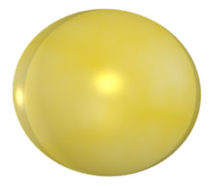










VLDL and Chylomicron Synthesis
TG
Liver
Cell
Blood
Vessel
Cytoplasm
LIVER
ER
Apo B100
Lumen
MTP
Nascent
VLDL
VLDL
LDL
TG
Intestinal
Epithelial
Cell
GUT
Cytoplasm
ER
Apo B48
Lumen
MTP
Chylomicron
Remnant
Hussain M, et al. J Lipid Res. 2003:44;22-32.
Nascent
Chylomicron
Chylomicron
Notes:
Speaker notes:
MTP serves 2 functions: stabilization of Apo B (i.e., prevention of degradation); and lipidation of Apo B to form VLDL in the liver or chylomicrons in the intestine. The Apo B-MTP complex binds to triglycerides, which bind directly to Apo B.
The nascent lipoprotein particles (VLDL in the liver and chylomicrons in the small intestine) grow by accumulating lipid as they pass through the ER and Golgi apparatus. The lipoprotein particles are then secreted into the bloodstream and VLDL is metabolized into LDL while chylomicrons are metabolized into chylomicron remnants.

Slide 72







MTP Inhibition Predicted to Reduce Production of Both Chylomicrons and VLDL
Intestinal Cell
Chylomicron
MTP
Diet Source
triglyceride
cholesterol
Apo B-48
Lomitapide Decreases
Secretion into the Blood
Liver Cell
MTP
Liver Source
triglyceride
cholesterol
Apo B-100
VLDL
Notes:
72
MTP inhibition is predicted to reduce production of chylomicrons from the intestines and of VLDL from the liver.
KW: MTP, Microsomal Triglyceride Transfer Protein, lipoprotein, apoB, chylomicron, VLDL

Slide 73
Lomitapide, an MTP Inhibitor
Once-a-day, orally-administered, small molecule drug currently in clinical development
PK/ADME
  T_{1/2} ~29 h for lomitapide, ~21 hours for primary metabolites (M1 and M3)
  High Volume of Distribution (~1200 L)
  Low absolute oral bioavailability: ~7%
  Metabolism primarily by CYP3A4
  Major route of excretion is feces
Clinical Development/Experience
  Clinical trials in patients with mild to moderate hypercholesterolemia and homozygous familial hypercholesterolemia
    Clinical experience with lomitapide: >900 patients
  Compassionate use experience in patient with Familial Chylomicronemia
Notes:
This slide summarizes available data on lomitapide, an MTP inhibitor in development.
KW: MTP, Microsomal Triglyceride Transfer Protein, lipoprotein, apoB, lomitapide, drug therapy, AEGR 733

Slide 74


Slide 75
HELLAS FH REGISTRY

Slide 76
REGISTRY FLOW
PATIENTS WITH LDL-C >190 mg/dL (ADULTS) OR >160 mg/dL (CHILDREN)
⬇
DUTCH LIPID CLINIC NETWORK CRITERIA ASSESSMENT
⬇
PROBABLE OR POSSIBLE OR DEFINITE FAMILIAL HYPERCHOLESTEROLEMIA
⬇
CASCADE FAMILY SCREENING
[GENETIC SCREENING]
[GENETIC SAMPLE STORAGE]
LONG-TERM FOLLOW-UP

Slide 77
ΥΠΕΡΧΟΛΗΣΤΕΡΟΛΑΙΜΙΑ
Πρωτοπαθής:
Οικογενής υπερχοληστερολαιμία
Οικογενής μικτή δυσλιπιδαμία
Πολυγονική υπερχοληστερολαιμία
Δευτεροπαθής:
Υποθυρεοειδισμός, νεφρωσικό σύνδρομο, πρωτοπαθής χολική κίρρωση

Slide 78
ΠΟΛΥΓΟΝΙΚΗ ΥΠΕΡΧΟΛΗΣΤΕΡΟΛΑΙΜΙΑ
Γενετικές διαταραχές + Περιβαλλοντικοί παράγοντες
(δίαιτα-⬆σωματικό βάρος, κ.λ.π.)
⬆ LDL CHOL

Slide 79

Σιτοστερολεμία - Εισαγωγή
Σπάνια αυτοσωμική υπολειπόμενη νόσος.
Πρώτη περιγραφή 1974.
Περίπου 100 περιπτώσεις έχουν περιγραφεί παγκοσμίως.
Γονιδιακή μετάλλαξη των ABCG5
και ABCG8
Εμφάνιση νόσου σε ομοζυγώτες

Slide 80

Σιτοστερολεμία – Μηχανισμός
Notes:
Free cholesterol (C) and plant sterols (PS) are mainly absorbed from the intestinal epithelium via the Niemann–Pick C1 like 1 (NPC1L1) transporter. Cholesteryl esters (CE) are formed by acyl coenzyme A:cholesterol acyltransferase 2 (ACAT2) and are assembled with apolipoprotein B-48 to form chylomicrons, which are secreted into the lymph, where they enter the systemic circulation. PS are poorly esterified by ACAT2. Both PS and cholesterol are secreted into the intestinal lumen via the heterodimer
ABCG5/ABCG8. Cholesterol may also be loaded by ABCA1 onto highdensity lipoproteins (HDL) at the intestinal basolateral membrane and then enter the lymphatic system. The liver can take up chylomicrons and HDLassociated cholesterol via low-density lipoprotein receptor (LDLR), LDLRrelated
protein (LRP), and scavenger receptor class B member 1 (SR-BI).
The liver can synthesize cholesterol de novo, excrete it into bile for biliary
secretion via ABCG5/ABCG8, or return it to the circulation via very low
density lipoprotein (VLDL) and HDL. Liver NPC1L1 can facilitate biliary
cholesterol reuptake. Deficiency of ABCG5 or ABCG8 in sitosterolemic
patients impairs excretion of PS into the intestinal lumen from enterocytes
and the liver, thereby resulting in a severe accumulation of PS in plasma
and tissues. Sitosterolemic patients have impaired liver cholesterol biosynthesis.
Current sitosterolemia therapy is based on a diet low in PS and
ezetimibe treatment. The use of cholestyramine may be recommended in
ezetimibe-resistant patients

Slide 81
Σιτοστερολεμία – Κλινική εικόνα
Σημεία πρώιμης αθηροσκλήρωσης
Σπληνομεγαλία
Χολολιθίαση
Αρθρίτιδες – Αρθραλγίες

Slide 82



Σιτοστερολεμία – Κλινική εικόνα
Ξανθώματα

Slide 83

Σιτοστερολεμία – Κλινική εικόνα
Ξανθώματα (σε ηλικία 18 μηνών)
Notes:
15-18 months old

Slide 84
Σιτοστερολεμία – Εργαστηριακά ευρήματα
Πολύ υψηλά επίπεδα στερολών στο αίμα (x 50-200)
(Φυσιολογικές τιμές στερολών στο αίμα < 1 mg/dl )
Φυσιολογικά ή αυξημένα επίπεδα ολικής χοληστερόλης
Σημεία αιμόλυσης
Θρομβοπενία με μεγάλα αιμοπετάλια
Διαταραχές της μορφολογίας των ερυθρών

Slide 85

Αιματολογική εικόνα
Notes:
«Σου στέλνω τη φωτογραφία που ζήτησες, όπου φαίνεται η στοματοκυττάρωση και η θρομβοπενία.»
Δες την διαφάνεια 23 που μοιάζουν για το ποια είναι τα αιμοπετάλια και ποια τα στοματοκύτταρα.

Slide 86

Σιτοστερολεμία – Εργαστηριακά
Notes:
Impaired ABCG5/ABCG8 heterodimer function in Abcg52/2 or Abcg82/2 hepatocytes and enterocytes leads to
increased plasma sterol levels. Sterols accumulate in the platelet membrane, resulting in calpain activation, reduced
aIIbb3 surface expression, loss of the GPIba-FlnA linkage, microparticle formation, and poor hemostatic functions.
Biochemical analysis shows that platelets
isolated from Abcg82/2 mice fed a high-sterol
diet have increased activation of the calciumactivated
protease calpain, resulting in loss
of the cytoskeletal and scaffold protein filamin
A (FlnA)

Slide 87
Σιτοστερολεμία – Διάγνωση
Πολύ αυξημένα επίπεδα στερολών (υγρή χρωματογραφία ή χρωματογραφία αερίου).
Μεταλλάξεις στα γονίδια ABCG5/ABCG8.

